Slide 1
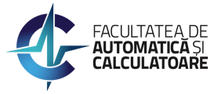
Elderly Assistance and Monitoring Using a Robotic Platform
Prof. PhD Eng. Irina Mocanu
irina.mocanu@upub.ro, http://aimas.cs.pub.ro/people/irina.mocanu/

Slide 2
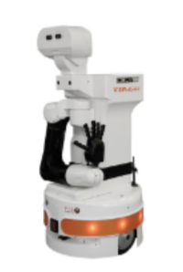
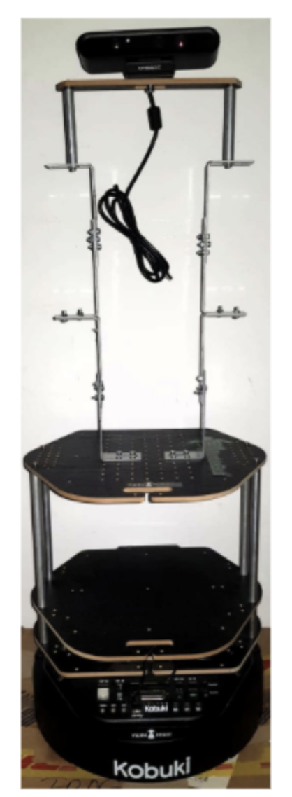
Introduction
Robots are being used in a wide variety of domains:
industry
social
entertainment or health care
monitoring activities of daily living
TurtleBot
TIAGo
Robots provided by IT Center for Science and Technology

Slide 3
Solution
Design a robotic framework for indoor monitoring and assistance
Implement modules suitable for the robotics framework:
human activity recognition
object recognition
gesture recognition for human-robot interaction
abnormal object detection
3

Slide 4
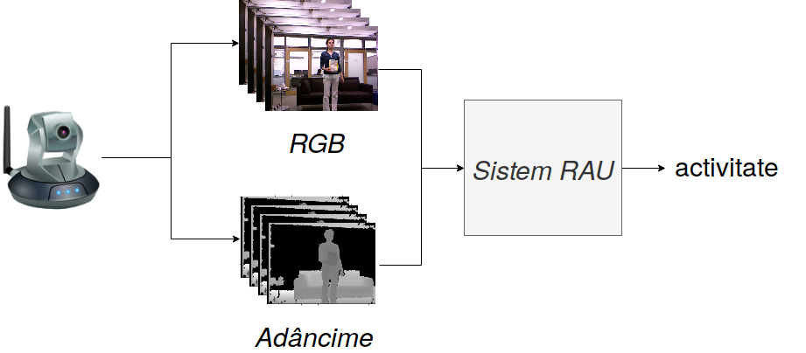
Human Activity Recognition
HAR
RGB
activity
Depth
Notes:
De ce m-am oprit asupra acestor obiective?

Slide 5
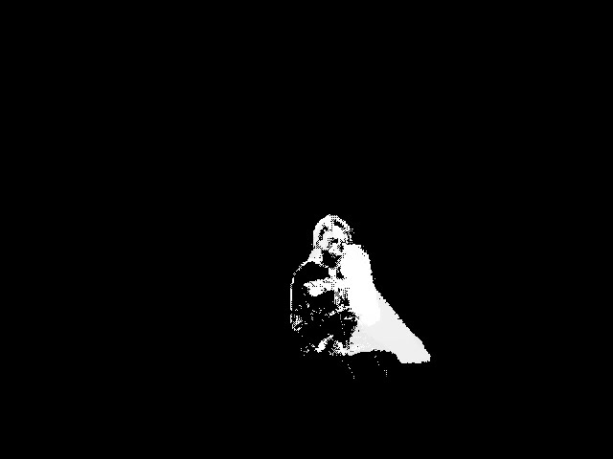
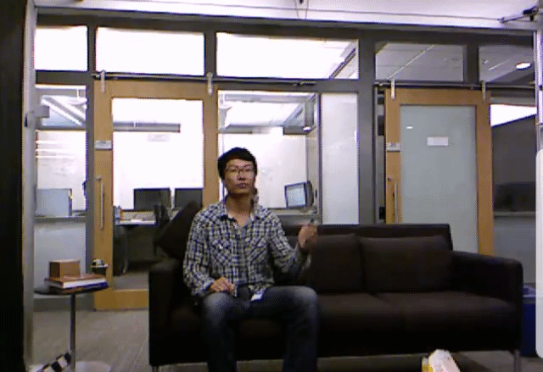
Fusion Mechanisms
Data fusion
Motion history images
Motion history images -static description of a temporal action.
Encode how an object or a subject move through time

Slide 6
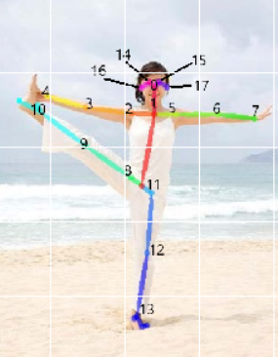
Fusion Mechanisms
Data fusion
Skeleton images
Skeleton images represent a visual summary of skeleton information present throughout a video.

Slide 7
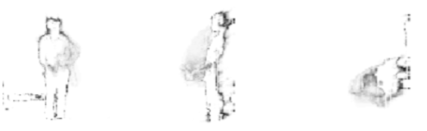
Fusion Mechanisms
Data fusion
Depth motion maps
Depth motion maps encapsulate motion information extracted from depth data.
front side view top
Notes:
Ca in majoritatea problemelor de invatare automata, dupa selectarea mecanismelor de lucru, ne-am izbit de problema gasirii unor parametri optimi pentru acestea. Citind lucrari recente si amintindu-ne contextul, am dat de urmatoarea idee:

Slide 8
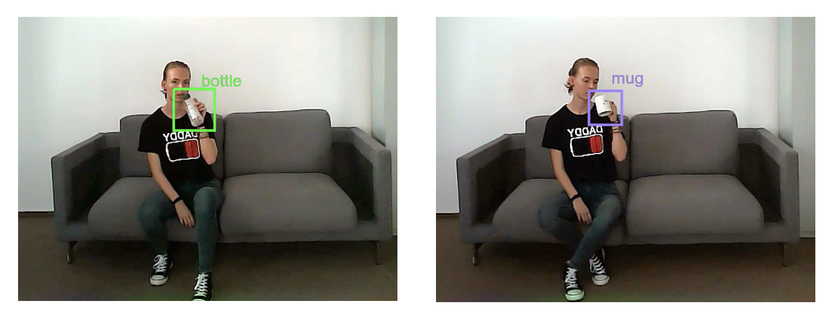
Fusion Mechanisms
Data fusion
Context
Notes:
Ca in majoritatea problemelor de invatare automata, dupa selectarea mecanismelor de lucru, ne-am izbit de problema gasirii unor parametri optimi pentru acestea. Citind lucrari recente si amintindu-ne contextul, am dat de urmatoarea idee:

Slide 9
Human Activity Recognition
Data fusion:
RGB images
Skeleton
Depth information
Context
Notes:
Voi prezenta un sistem de recunoastere a activitatilor umane care se bazeaza pe fuziunea datelor se vor utiliza toate informatiilor preluate dintr-un video RGB-D. Astfel vom utiliza atat fluxul de date RGB, scheletul uman, obiectele identificate in imagini, precum si fluxul de date de adancime, proiectat pe 3 plane: fata, sus si lateral.

Slide 10
Human Activity Recognition
object list
object list
max
Notes:
Pentru a ii testa eficienta si corectitudinea, am folosit 2 seturi de date:

Slide 11
Time Fusioning
Motion history images
Skeleton images
Depth motion maps

Slide 12
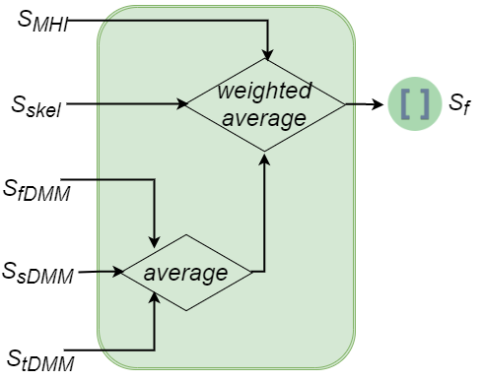
Channel Fusioning
Motion history images
Skeleton images
Depth motion maps

Slide 13
Automated Machine Learning
Automated machine learning:
Finding optimal architecture
Fine tuning of parameters
Google AutoML:
Fast training
Model is not provided (it can be used)
Notes:
Pentru alegerea arhitecturii optime si optimizarea parametrilor acestor retele componente am utilizat solutia bazata pe automated machine learning si anume solutia oferita de Google, Google AutoML …
Avantaj: durata mica de antrenare, dezavantaj nu este furnizat modelul retelei, poate fi salvat.

Slide 14
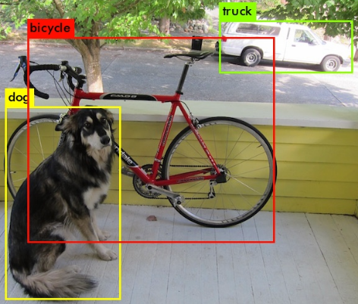
Context Fusioning
Object recognition: YOLOv4
5 frames with objects are randomly selected
Objects: person, bottle, cup, sofa, laptop, cell phone, book

Slide 15
Datasets
Public dataset: MSRDailyActivity3D (320 videos)
16 different activities: drink, eat, read book, call cell-phone, write on a paper, use laptop, use vacuum cleaner, cheer up, sit still, toss paper, play game, lay down on sofa, walk, play guitar, stand up, sit down,
Each activity is performed twice (once standing up, once sitting down) by ten subjects, in an office.
Notes:
Pentru a ii testa eficienta si corectitudinea, am folosit 2 seturi de date:

Slide 16
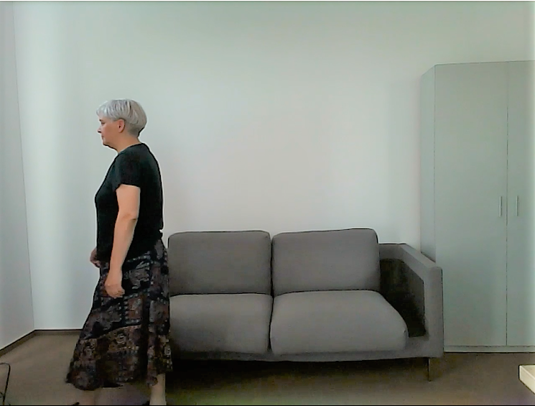
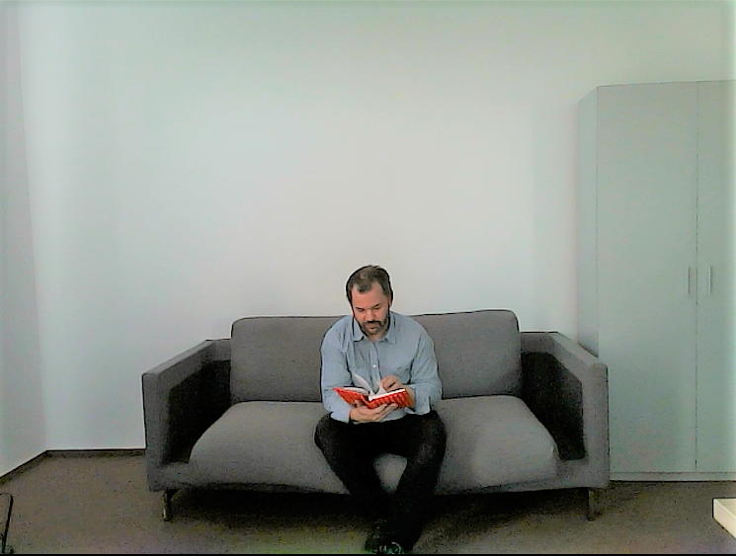
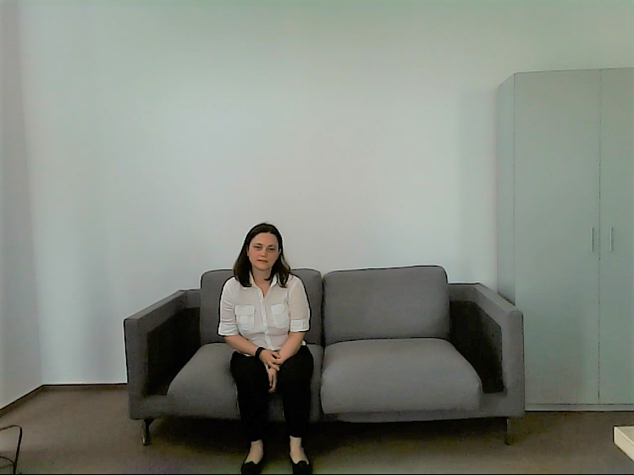
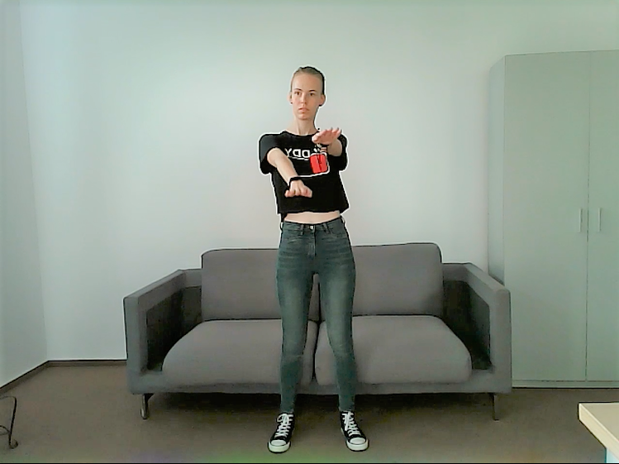
PRECIS HAR Dataset
PRECIS HAR:
: PRECIS HAR (800 video)
50 subjects
16 activities: stand up, sit down, sit still, read, write, cheer up, walk, throw paper, drink from a bottle, drink from a mug, move hands in front of the body, move hands close to the body, raise one hand up, raise one leg up, fall from bed and faint

Slide 17
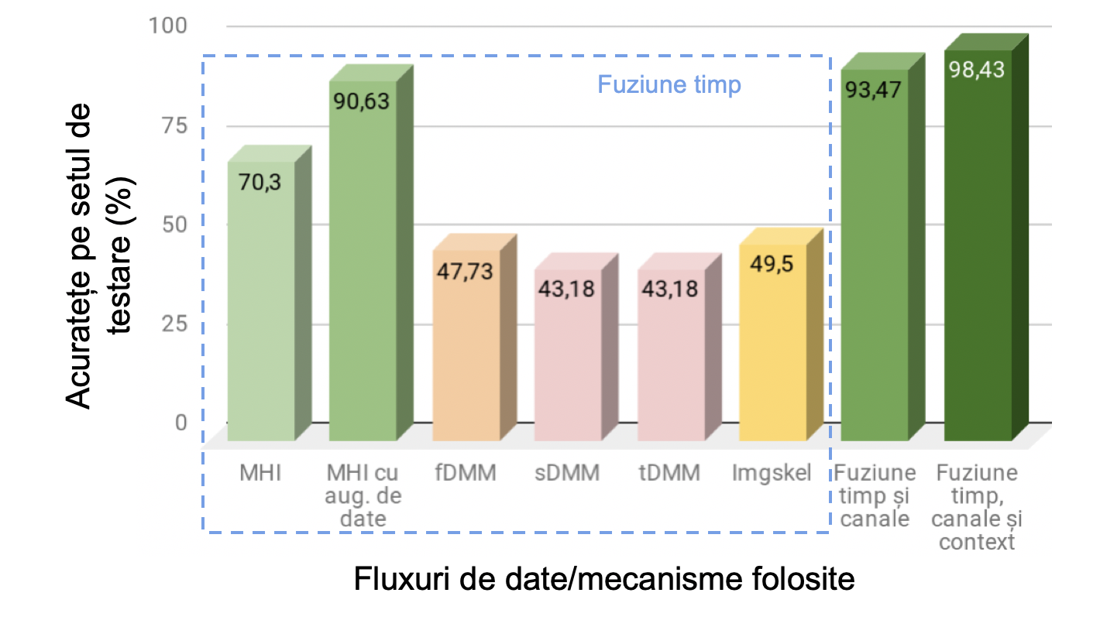
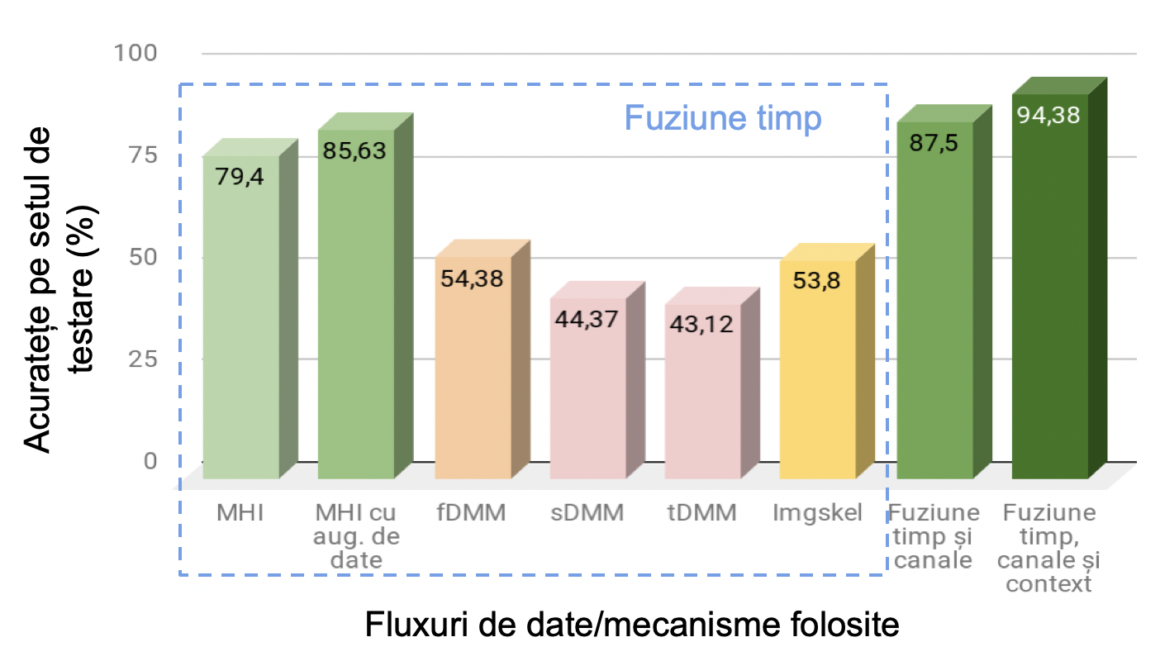
Evaluation
Accuracy
Accuracy
Data fusion
Data fusion
MSRDailyActivity3D
PRECIS HAR

Slide 18
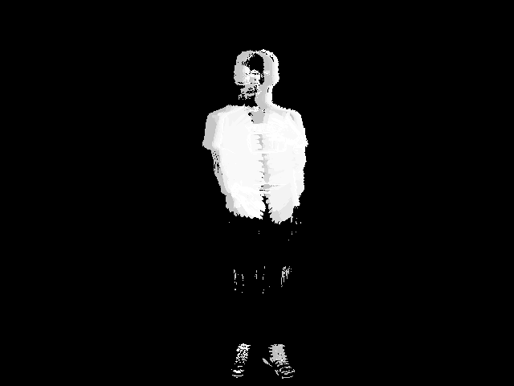
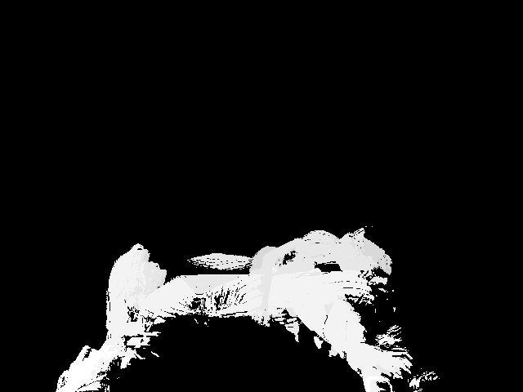
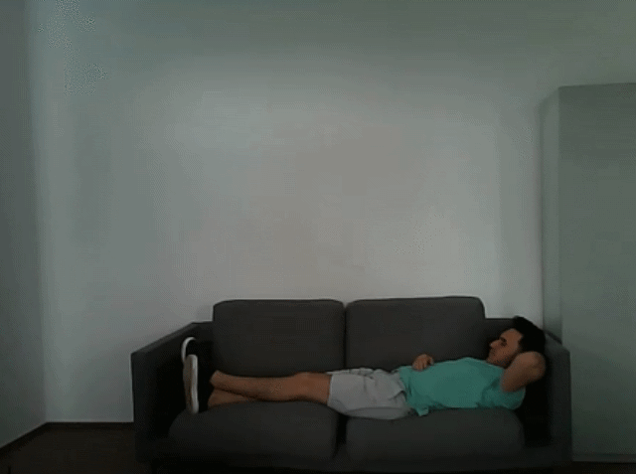
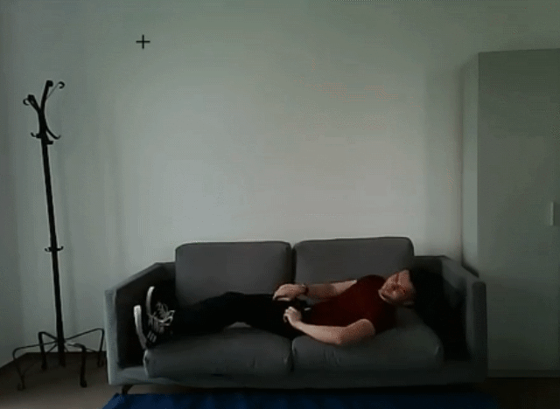
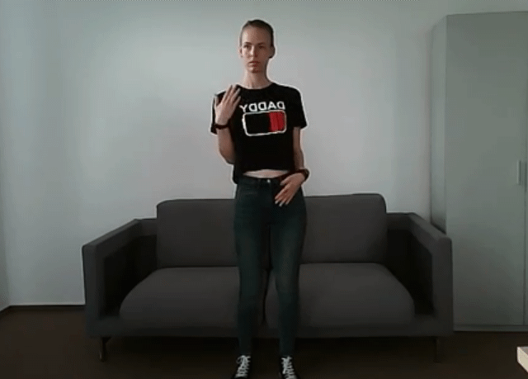
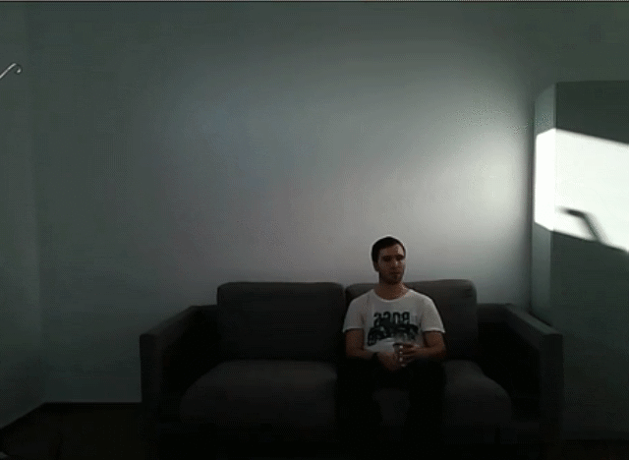
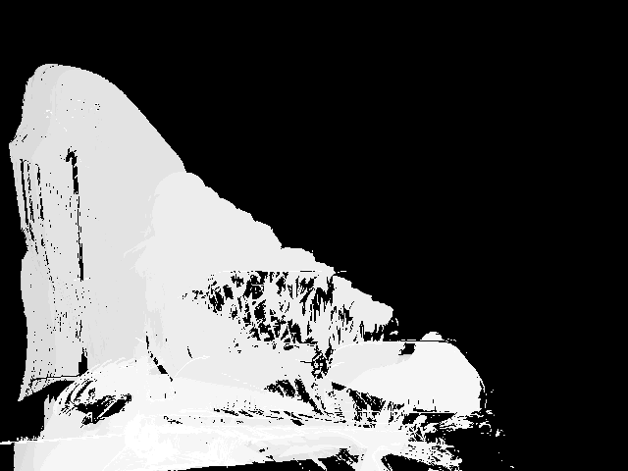
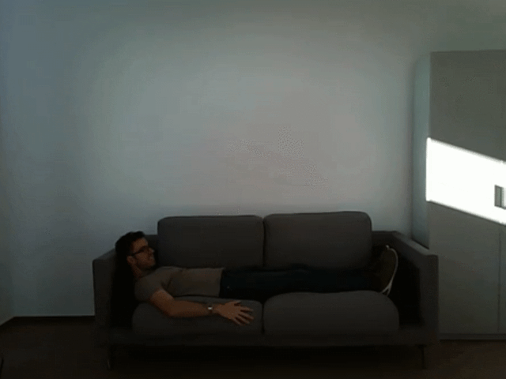
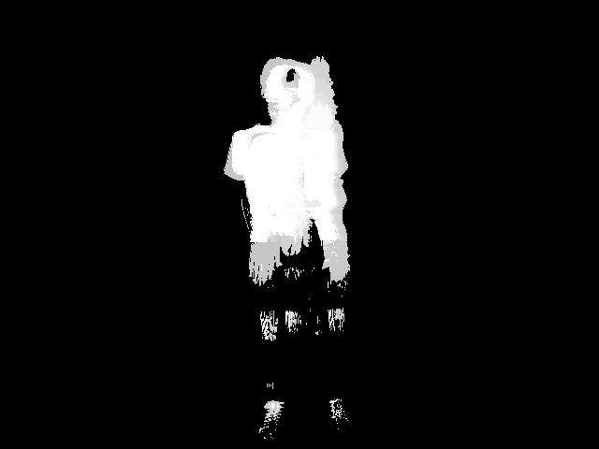
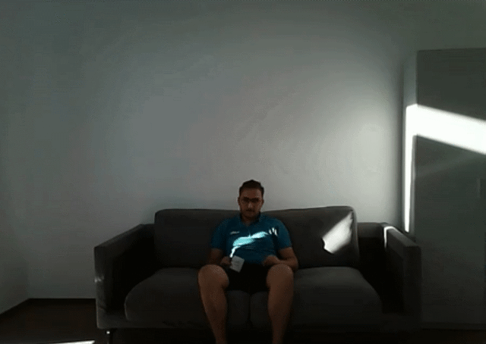
Correct classifications
fall from bed hands close to the body raise one hand up drink from a bottle
faint hands in front of the body raise one leg up drink from a mug
Notes:
Dupa cum am aratat, clasificam activitati pe baza mai multor fluxuri de informatii. Totusi, nici chiar in acest caz nu putem atinge acuratete maxima.

Slide 19
Difficult classifications
MSRDailyActivity3D:
writing vs. reading vs. laptop
PRECIS HAR :
writing vs. reading
Notes:
Totusi, sistemul proiectat are o pozitie buna in raport cu sistemele din literatura de specialitate.

Slide 20
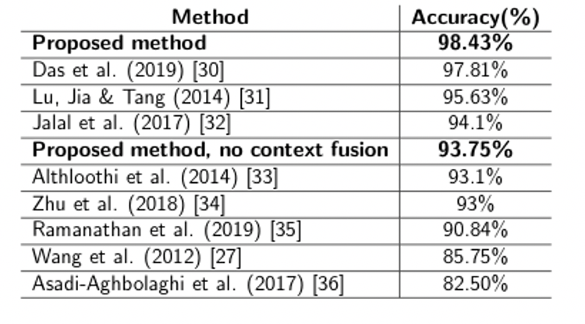
Evaluation
MSRDailyActivity3D
Time
training: 10 - 15 minute
classification: 0.1 - 1.8 sec
Notes:
Pe langa acuratete, am testat si alte caracteristici.

Slide 21
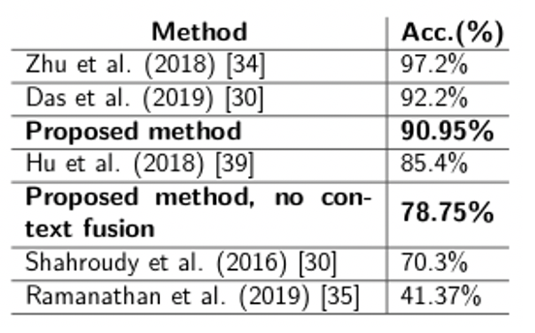
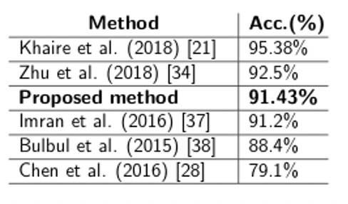
Evaluation
NTU RGB+D: 60 classes
UTD-MHAD: 26 classes
Context fusion is relevant for datasets that contains users that interacts with objects
Notes:
Pe langa acuratete, am testat si alte caracteristici.

Slide 22
Difficult classification
UTD-MHAD:
catch - knock
NTU RGB+D:
salute - brush teeth

Slide 23
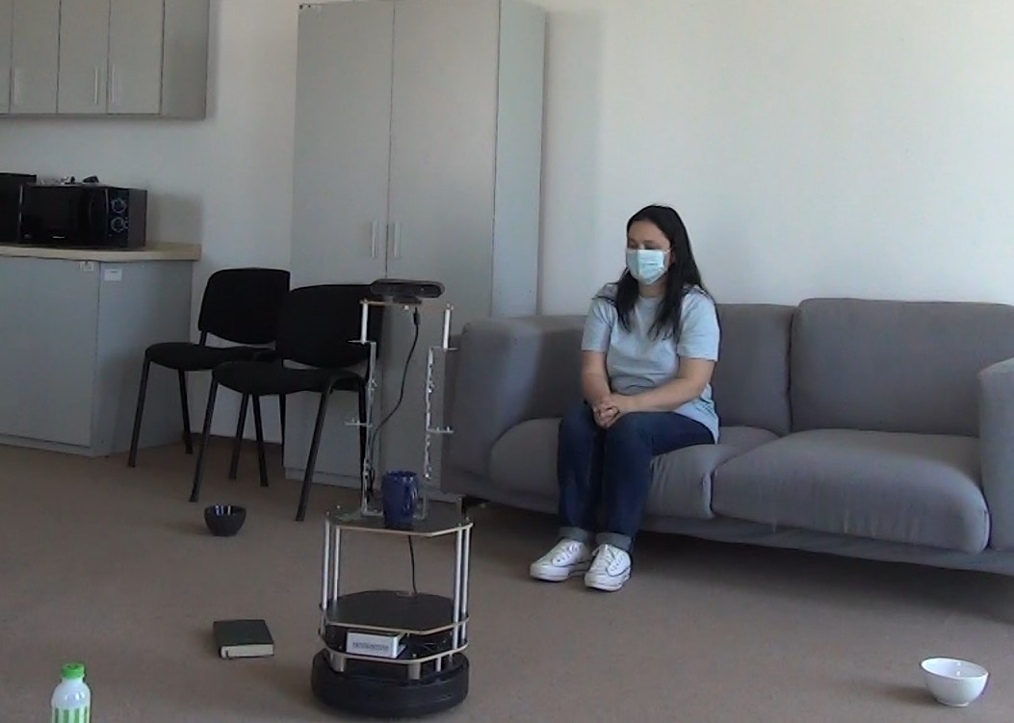
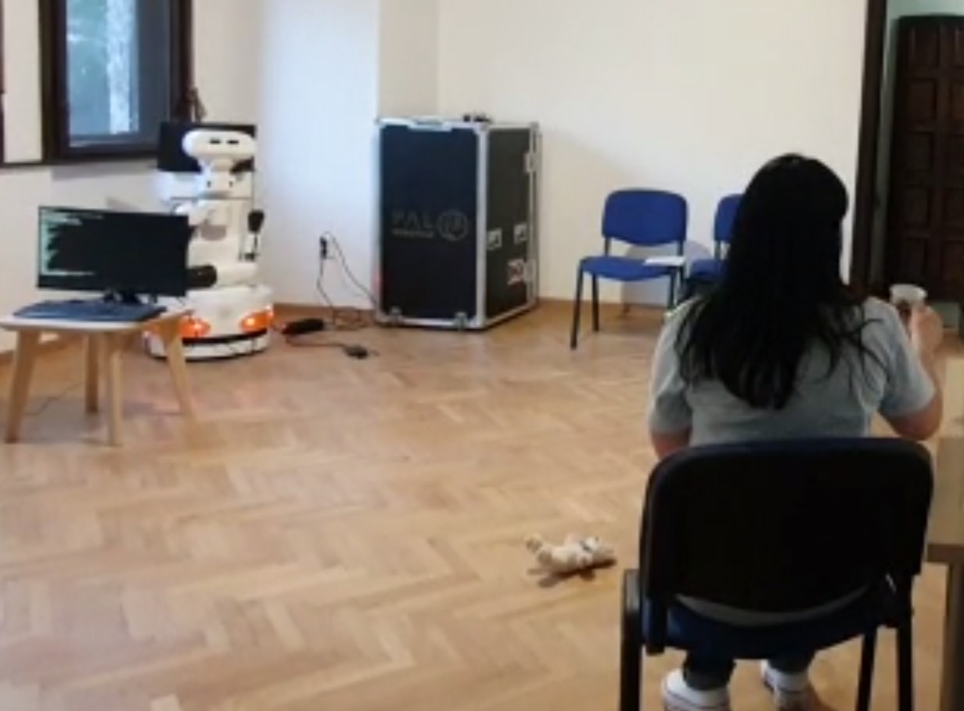
Testing with robotic platforms
TIAGo
TurtleBot

Slide 24
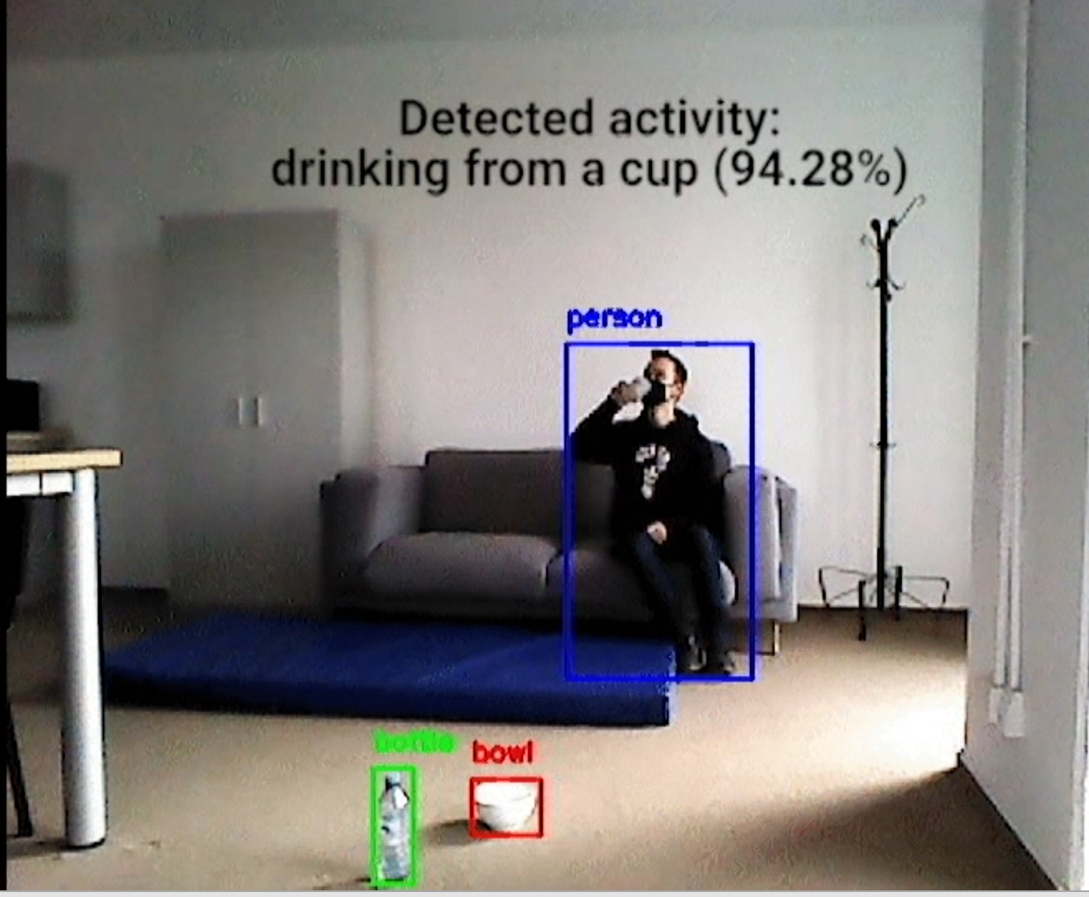
Activity Recognition

Slide 25
Object Detection
Classical object detectors are the single-frame ones like YOLO
Single-frame object detection has significant drawbacks:
it fails when objects are partially occluded/filmed from particular angles,
can lack either speed or accuracy when ported on real-life applications—that can lead to functional anomalies.
Multi-frame object detection solves the previously stated drawbacks

Slide 26
Object Detection
Center-based descriptor
Describe an object by using only the central point of its bounding box
Infer via regression other properties (size, location, orientation) from the keypoint feature in the center
Train a fully connected network that generates heatmaps;
The peaks in the heatmap will represent the centers of the predicted objects.

Slide 27
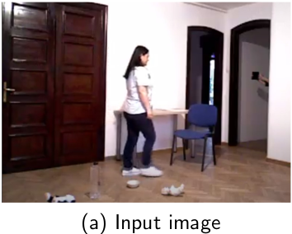
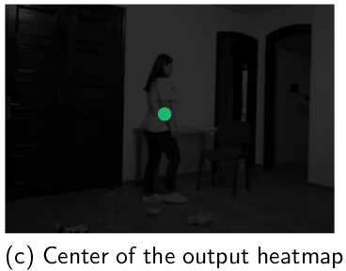
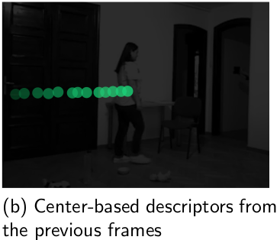
Object Detection
Preprocessing module
Neural network based on a deep layer aggregation architecture
current frame
Infer size and orientation
infer the centers of the objects, the sizes of the bounding boxes, as well as their orientation.
motion history map of the center-based descriptors from the previous n frames
13

Slide 28
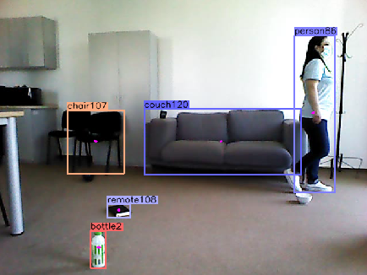
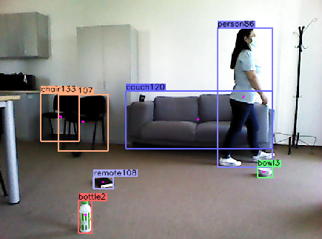
Object Detection

Slide 29
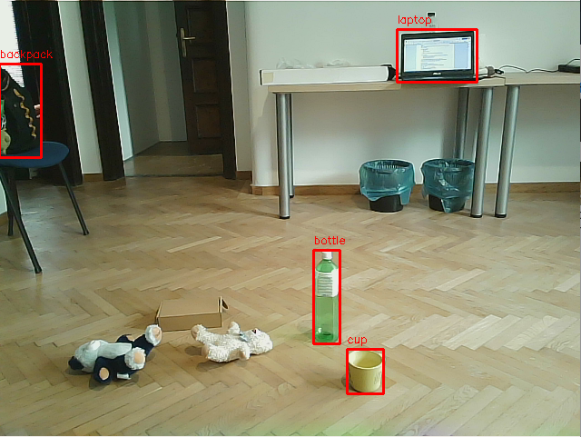
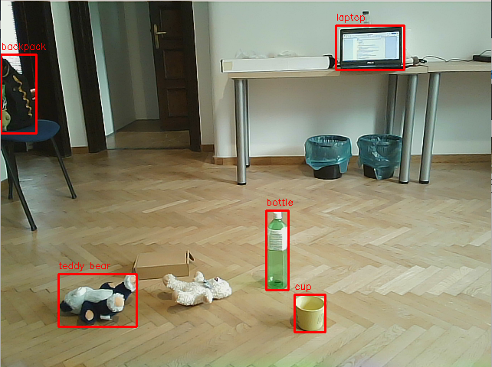
Object Detection

Slide 30
Abnormal Object Detection
Two-phase complex system for plane segmentation

Slide 31
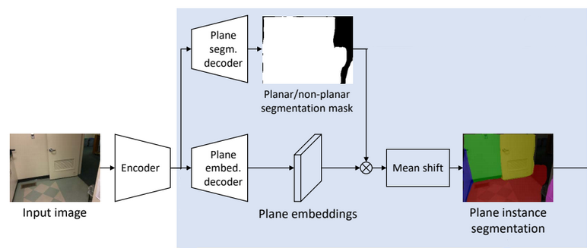
Abnormal Object Detection
Plane segmentation:
Encoder-decoder architecture that is capable of distinguishing between regions that are planar and that are not.
Encoder: an extended version of ResNet-101 Feature Pyramid Network, pre-trained on ImageNet
Classification in plane regions is made using the mean shift clustering
Using depth data - the ground should be a plan that is lower than the other plans, on which the robot sits and that is large enough in the picture.

Slide 32
Abnormal Object Detection
Improved the plane segmentation by including depth data as direct input in the encoder-decoder of the architecture.
The depth information is used in an earlier stage, by encoding it in the encoder component of the plane segmentation component.
Process of transforming the simple architecture of the plane detection mechanism into a more robust one

Slide 33
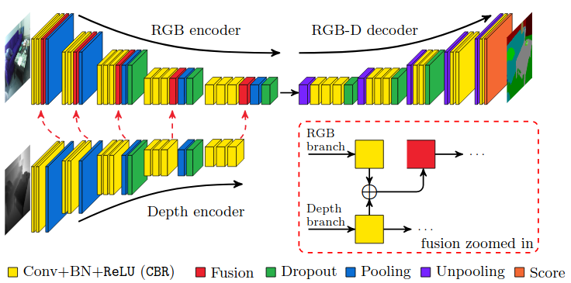
Abnormal Object Detection
FuseNet - the depth encoded information is progressively merged in the RGB encoded one.
The network has two branches, each of them being specialized in extracting features from a type of information stream—RGB or depth data.
The feature maps extracted from the depth stream are progressively merged into the ones extracted from the RGB data.

Slide 34
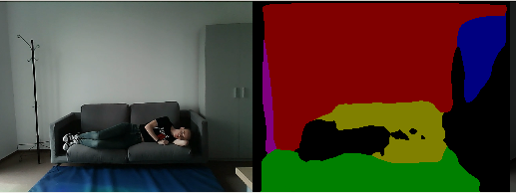
Abnormal Object Detection- Qualitative Results
Not every plane is fully identified, but the floor plan is correctly marked

Slide 35
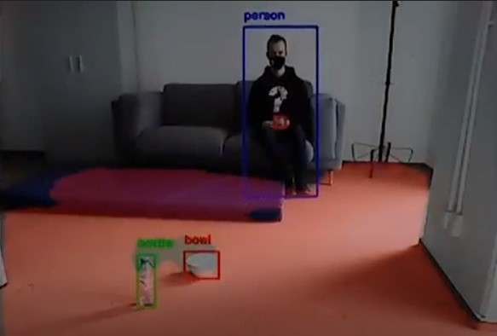
Abnormal Object Detection- Qualitative Results
Most of the qualitative experiments were successful, proving the fact that the proposed ground segmentation and object detection mechanism are suitable for being used in abnormal object detection

Slide 36
Gesture Recognition
Aimed to be an accessible interface between the robot and the human
Hand area detection based on skeleton and depth information
Simple CNN architecture, operating on binary images
Simple CNN architecture contains:
7 hidden layers (2D convolutions followed by 2D max pooling) with ReLU as activation function, and dropout and one fully connected layer with softmax activation in the end.
The optimizer is Adam and the loss functions is cross-entropy.

Slide 37
Gesture Recognition
The CNN gets as input binary images of reduced size (e.g. 100×100 pixels) representing shapes of the hand.

Slide 38
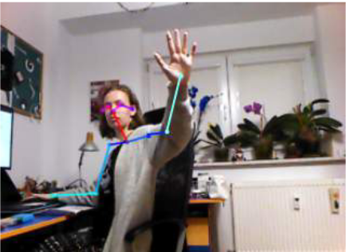
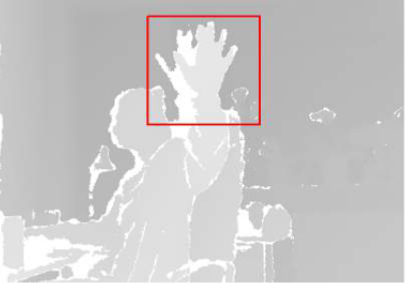
Gesture Recognition
The detection of the hand area currently is based on the depth information and skeleton.
The person points towards the robot when performing an interaction gesture:
they are facing the robot
the closest points in the point cloud to the robot correspond to the hand.

Slide 39
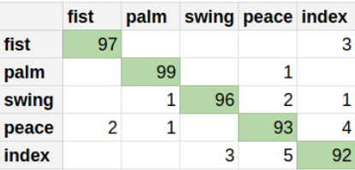
Gesture Recognition
Confusion matrix
95.4% accuracy on own dataset
with 1000 samples per class.

Slide 40
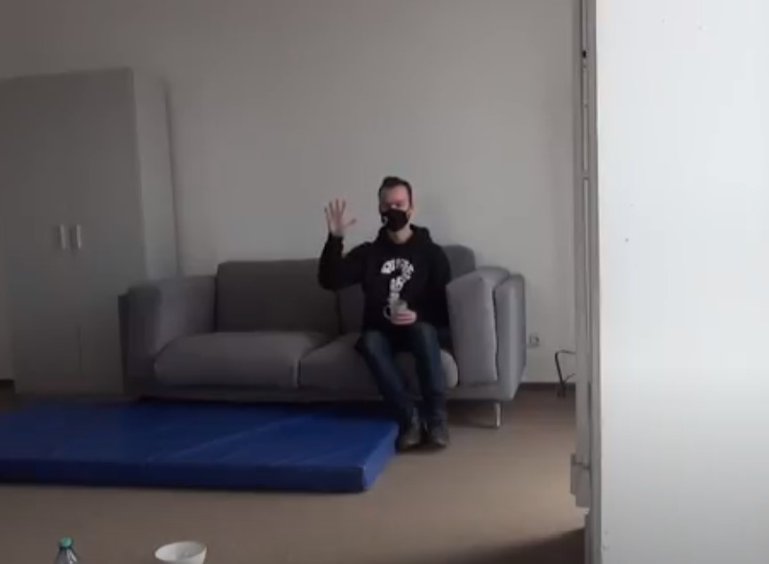
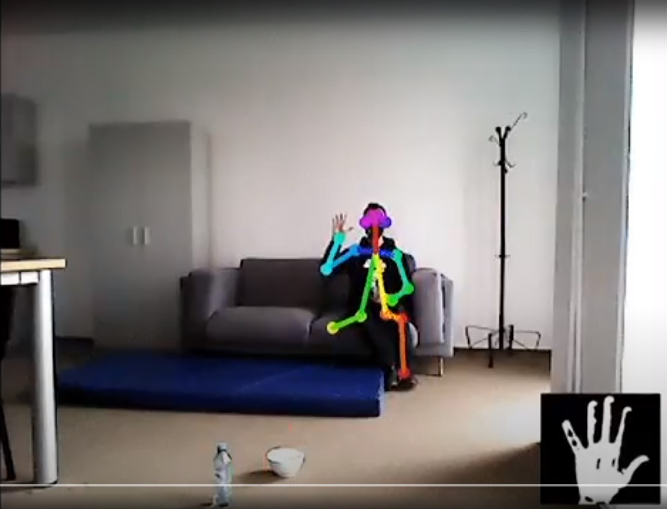
Gesture Recognition
Gesture recognition: palm identification with the help of the skeleton and gesture identification as “palm

Slide 41
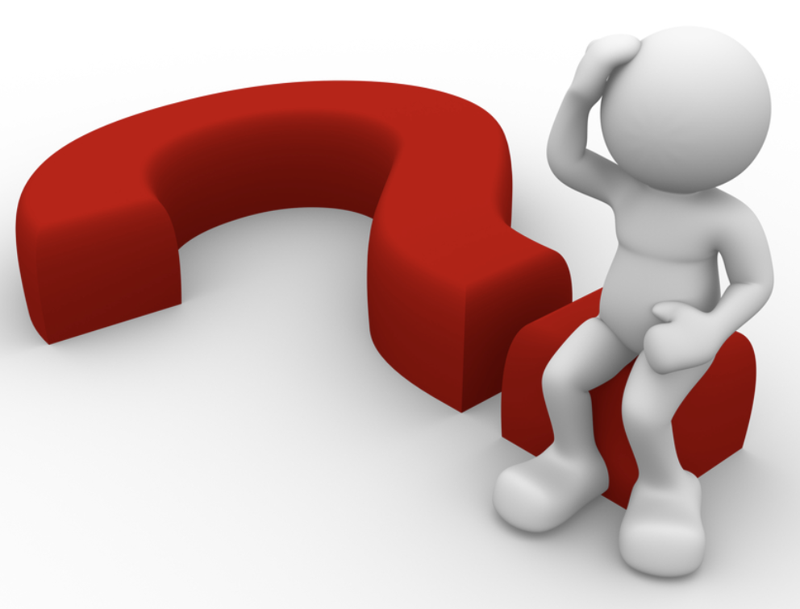
Thank you!
irina.mocanu@upb.ro

