Slide 1
Security, Privacy and Ethical Issues in next-gen Automotive
Ashish Ashutosh
FIT Europe 2022

Slide 2
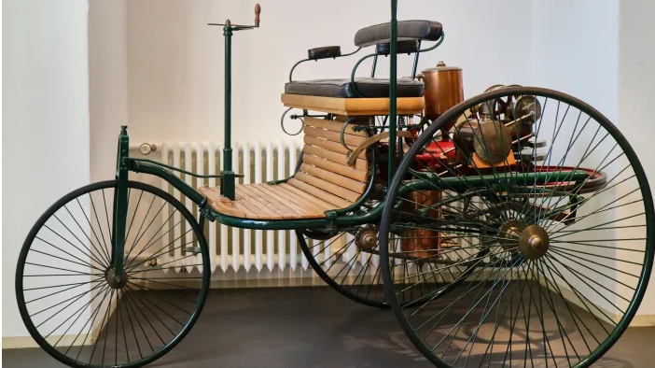
Carl Benz Patents World’s First Automobile
www.history.com/news/car-history-timeline

Slide 3
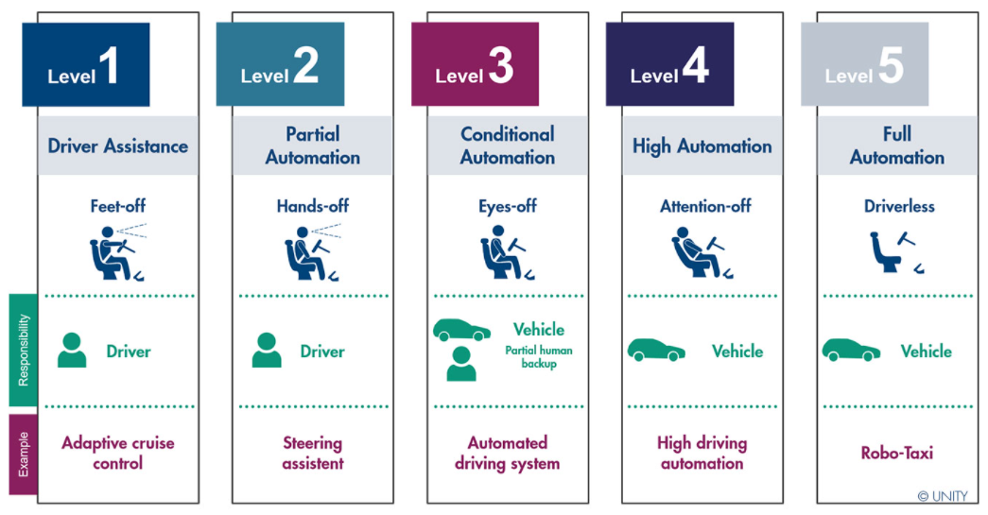
SAE J3016
Levels of Automation(https://www.unity.de/en/services/systems-engineering/automated-driving-through-systems-engineering/)

Slide 4
Connected Vehicle Ecosystem
V2N
Vehicle to Network
V2I
Vehicle to Infrastructure
V2P
Vehicle to Pedestrian
V2V
Vehicle to Vehicle
V2P
Vehicle to Pedestrian
V2X Communication

Slide 5
Vehicle Data
Camera
GPS Sensor
Microphone
Fuel Sensor
Speed Sensor
CO2 Exhaust Sensor
Examples of sensor data generated inside a vehicle

Slide 6
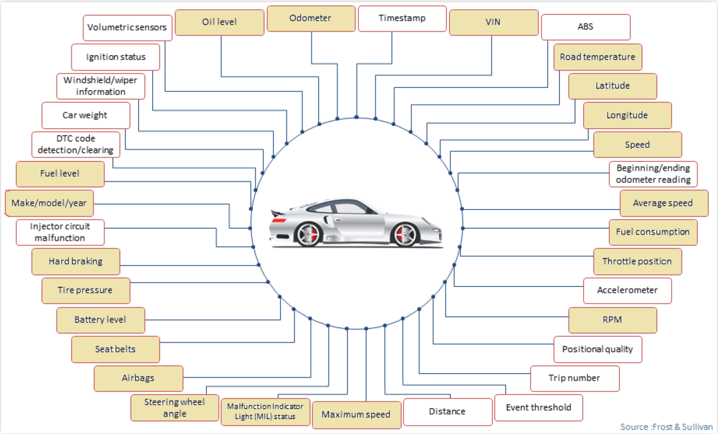
More Vehicle Data

Slide 7
What features would you want in your vehicle?

Slide 8
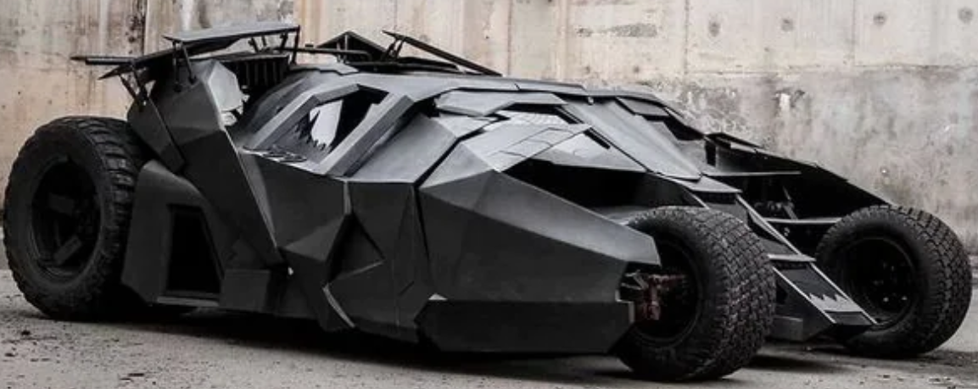
What features would you want in your vehicle?
https://auto.hindustantimes.com/auto/cars/this-electric-batmobile-tumbler-replica-is-batman-s-green-ride-could-be-yours-41645407269573.html

Slide 9
Privacy related attacks
3 main types of privacy attacks [2]:
Driver fingerprinting: Identifying a driver among a set of other driver candidates.
Enev and team [1] study – data from 15 sensors
Location inference: Identifying location even when not explicitly disclosed
Dewri and team [3] study – speed and steering wheel angle data.
Driving behavior analysis
Data collected by Usage Based Insurance (UBI) companies – mileage, speed, acceleration, hard braking – to detect distracted or drunk driving.

Slide 10
Risks related to different sensors
Riskiest sensors
Location, current speed, steering wheel angle
Riskiest sensors in combination
Fuel consumption and hard breaking
Least privacy risks
Outside temperature, average speed, maximum speed, battery level, check engine light on, oil level

Slide 11
Possible solutions to protect sensor data?

Slide 12
Some Challenges
OEM: Original Equipment Manufacturers
ECU: Electronic Control Units
CAN: Controller Area Network
Interoperability
Polling frequency
Dissemination of vehicle data
Vehicle Data Platform and Cloud Services
Externally Shared Data
OEM Services
3rd Party Services
ECU
In-vehicle Generated Data
ECU

Slide 13
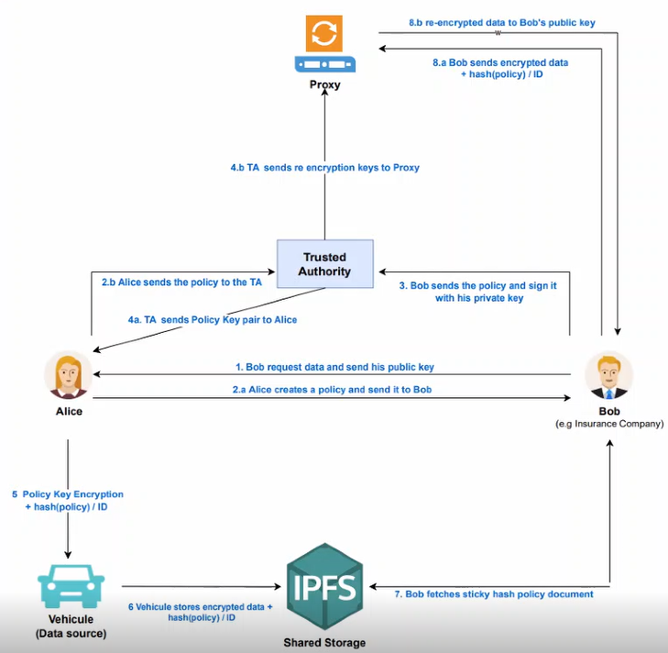
Dissemination of vehicle data

Slide 14
Vision
Policy
(AC & Privacy Settings)
Policy
User
Access Control
Policy
Policy
Cloud Services
Pedestrian

Slide 15
Ethical dilemma

Slide 16
Do you think Humans should control vehicles?

Slide 17
Who is responsible for accidents in self driving cars?

Slide 18
Is there a trade off between safety and speed?

Slide 19
What infrastructure changes are necessary to accomodate connected vehicles?

Slide 20
Connected Vehicle Ecosystem
V2N
Vehicle to Network
V2I
Vehicle to Infrastructure
V2P
Vehicle to Pedestrian
V2V
Vehicle to Vehicle
V2P
Vehicle to Pedestrian
V2X Communication

Slide 21
References
Enev, M. et al., “Automobile Driver Fingerprinting,” Proceedings on Privacy Enhancing Technologies 1:34-50, 2016.
Pesé, M. and Shin, K., "Survey of Automotive Privacy Regulations and Privacy-Related Attacks," SAE Technical Paper 2019-01-0479, 2019, https://doi.org/10.4271/2019-01-0479
Dewri, R., Annadata, P., Eltarjaman, W., and Thurimella, R., “Inferring Trip Destinations from Driving Habits Data,” in Proceedings of the 12th ACM Workshop on Privacy in the Electronic Society, 267-272, ACM, November 2013).

