Slide 1
ATOMIC SWAP Privacy Preserving
Tymofii Melnyk
Davide Massini
Maria-Elena Andreescu
Bogdan-Adrian Nazare Vahid Bajalan
Fabio Mussi
Guillaume Berthomet
Lorenzo Frasconi
Erwan Versmée
19.11.2021

Slide 2
Outline
1
2
Critical issues
Introduction
3
4
Our solution
Conclusion

Slide 3
1
Introduction
Basic atomic swap knowledge

Slide 4
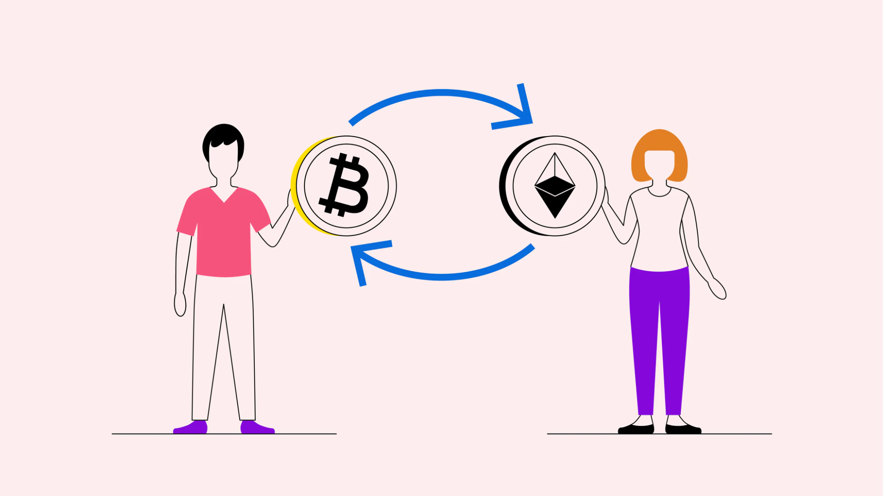
Atomic swap
Atomic swaps are automatic exchange contracts that allow two parties to trade tokens from two different blockchains
https://www.bitpanda.com/academy/en/lessons/what-is-an-atomic-swap/

Slide 5
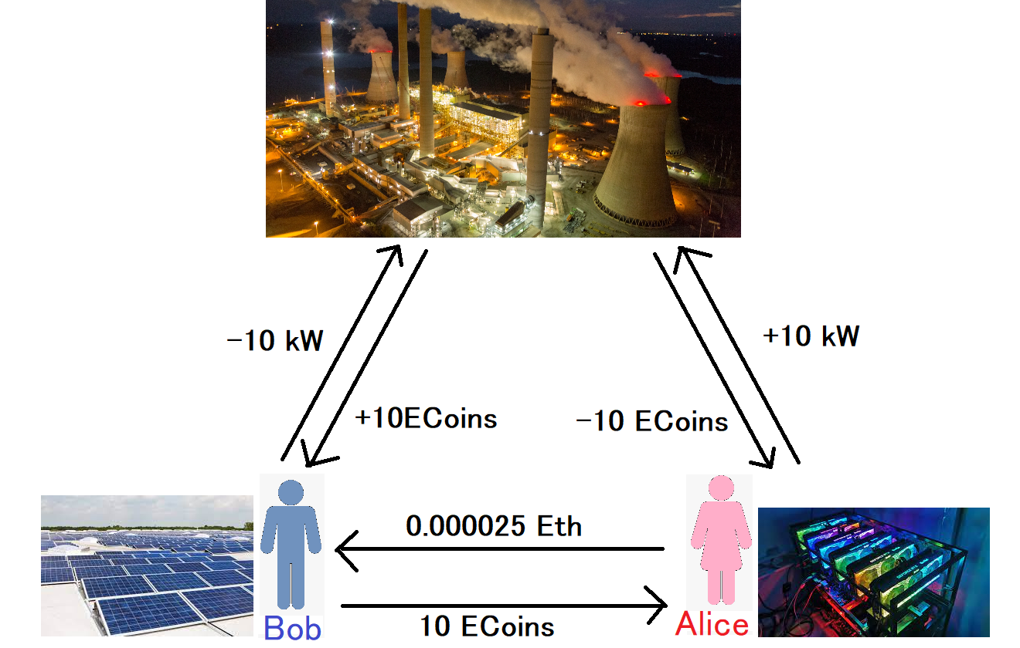
Use case
CryptoMining Rig: cryptomining-blog, Solar array mounted on a rooftop (Wikipedia),Power Plant: Robb Kendrick - Nat Geographic Photo Collection

Slide 6
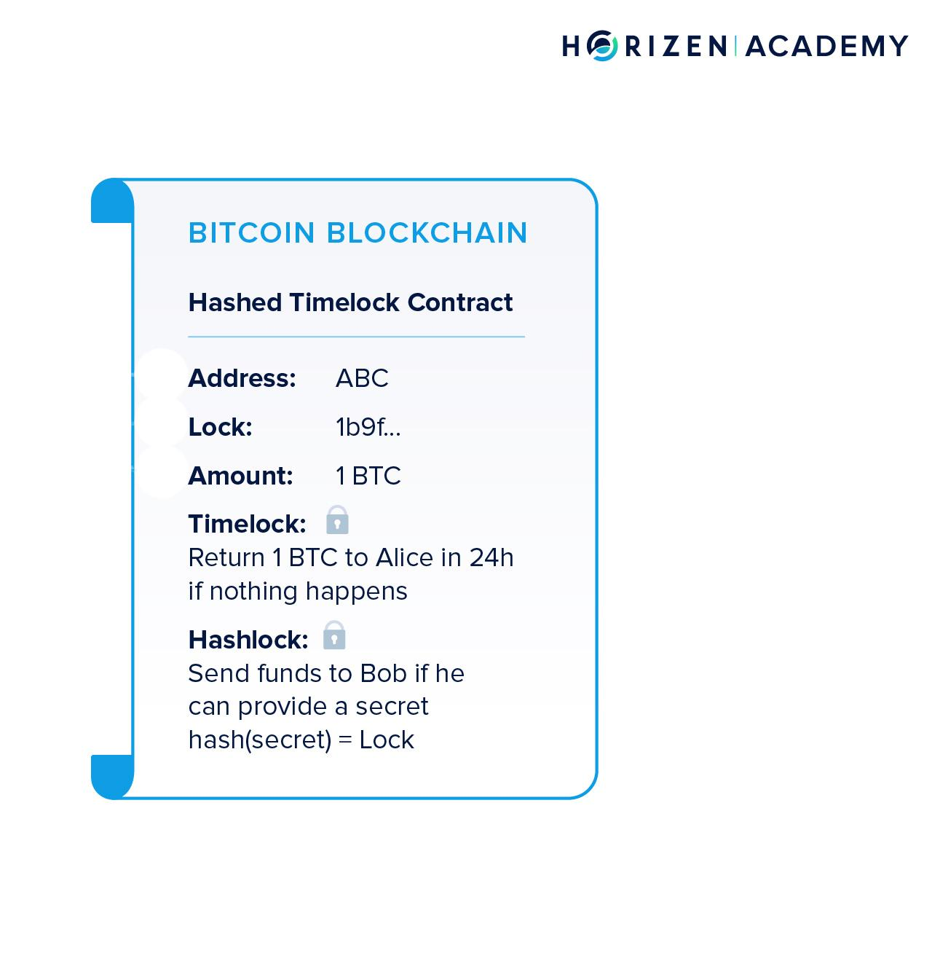
Hash Time Lock Contracts
A Hashed Timelock Contract (HTLC) is a type of smart contract used in blockchain applications to eliminate counterparty risk by enabling the implementation of time-bound transactions
https://academy.horizen.io/technology/advanced/atomic-swaps/

Slide 7
2
Critical issues
Privacy shortcomings

Slide 8
User addresses are explicitly used in contracts
Transactions on both chains are easily identifiable via same secret key
Values, tokens amounts, prices are public

Slide 9
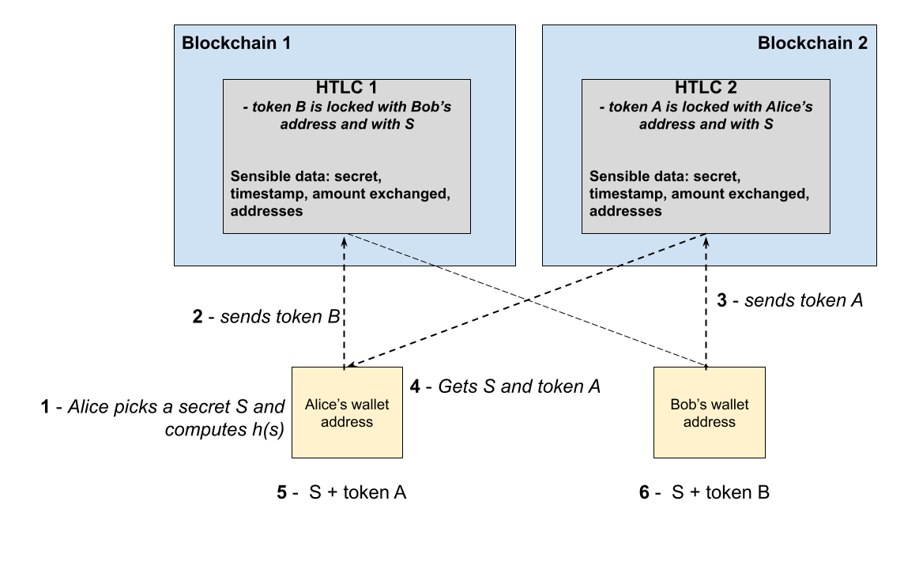
General cross-chain overview

Slide 10
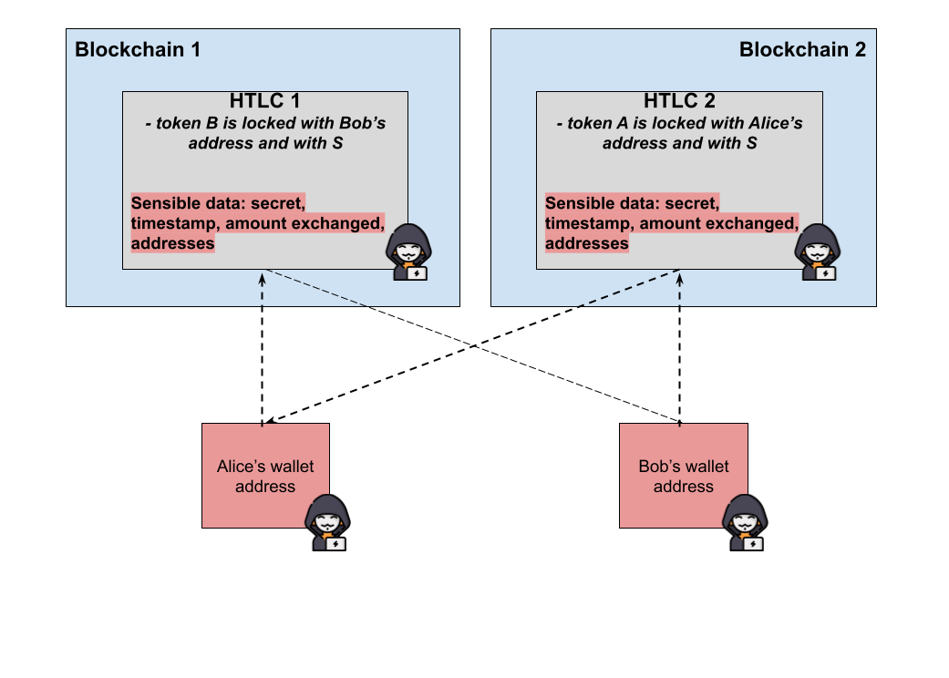
The anonymity problem

Slide 11
Privacy issues
3FZbgi29cpjq2GjdwV8eyHuJJnkLtktZc5
Alice
Bitcoin Address
Block 1
Transaction X
Alice sends X Tokens to BMW’s account at 4 P.M.
Transaction X
Transaction X
Transaction X
Block 2
Transaction X
Transaction X
Alice sends X Tokens to Gas provider account at 8 P.M.
Transaction X
Transaction X
Block 3
Alice sends X Tokens to unknown address at 10 A.M.
Transaction X
Transaction X
Transaction X
Transaction X

Slide 12
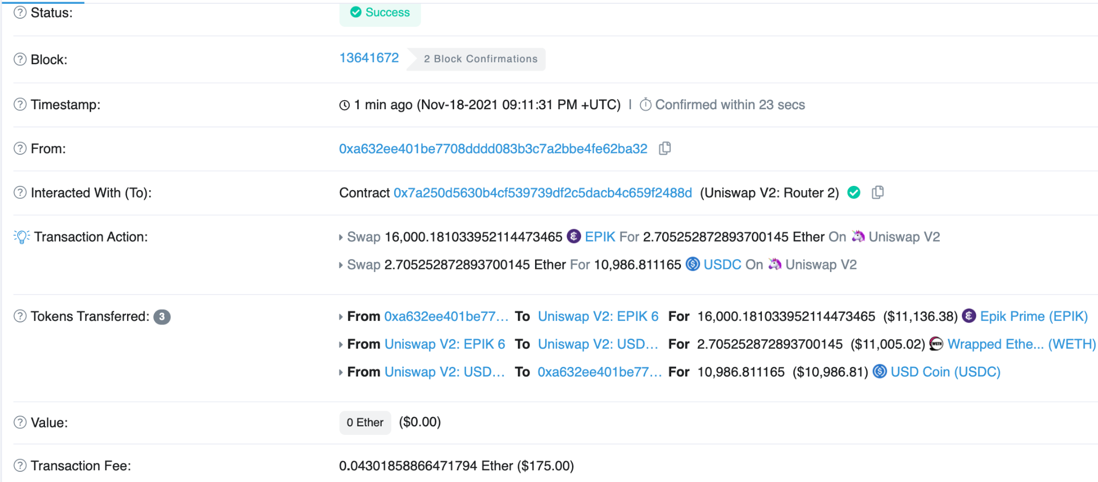
Privacy issues

Slide 13
3
Our solution
What we reached & what can be optimized?

Slide 14
zkSNARK algorithm - proof construction where one can prove possession of certain information, e.g. a secret key, without revealing that information, and without any interaction between the prover and verifier.
Tornado.Cash/Mixer - improves transaction privacy by breaking the on-chain link between source and destination addresses
Atomic Release of Secrets

Slide 15
First Mixer Solution
Blockchain’s transactions
Bob sends N$ to Mixer
Exchange of Tokens on the same Blockchain with a Mixer
Mixer sends N$ to Bob temp. account
Bob temp. account sends N$ to Smart Contract
Mixer
Smart Contract
Simple Exchange of Tokens
Smart Contract sends N$ to Alice temp. account
Bob’s account
1
2
Bob temporary account
3
Alice temp. account sends N$ to Mixer
Mixer sends N$ to Alice
Blockchain’s actual block
S sends N0$ to Z
Bob sends N$ to Mixer
A sends N1$ to B
X sends N2$ to Y
I sends N3$ to J
E sends N4$ to F
Mixer sends N$ to Bob temp. account
F sends N6$ to G
H sends N$ to P
R sends N8$ to D
Q sends N9$ to O
L sends N2$ to W
Alice’s account
6
5
Alice temporary account
4
The others transactions may be in other blocks, spaced in time

Slide 16
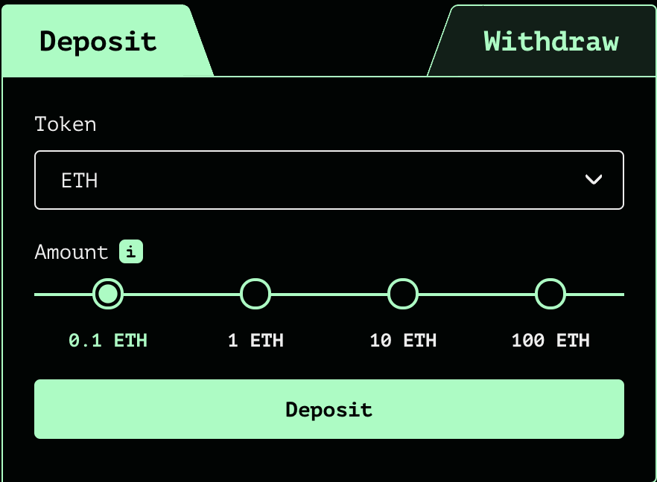
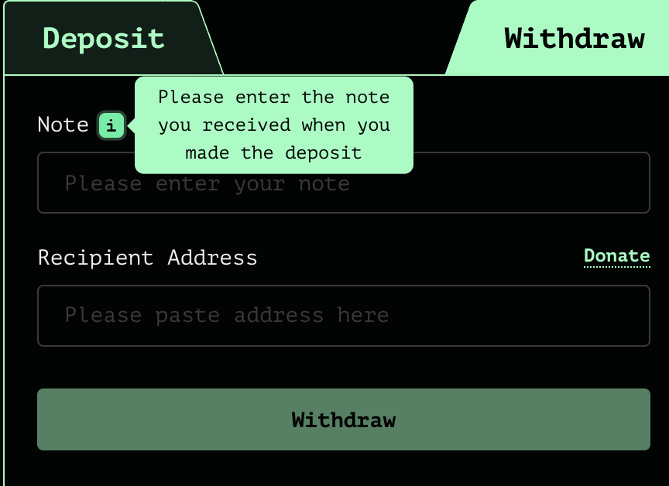

Slide 17
Atomic Release of Secrets
Diffie-Hellman key-exchange
Deployment of HTLC contracts process
BTC
ETH
HTLC
Create new secret and push g^sA + send 2BTC
Verify this contract satisfies predecided conditions
Lorenzo
Bogdan

Slide 18
Unlinking identities on cross blockchain swap
3. Tokens claiming process
BTC
ETH
HTLC
HTLC
Compute sB = sA + z
claims 5ETH
Reveal sB
Publish g^(sA + z)
send 5ETH
Lorenzo
Bogdan

Slide 19
Unlinking identities on cross blockchain swap
3. Tokens claiming process
BTC
ETH
HTLC
HTLC
Claim 2BTC using sA = sB - z
Lorenzo
Bogdan

Slide 20
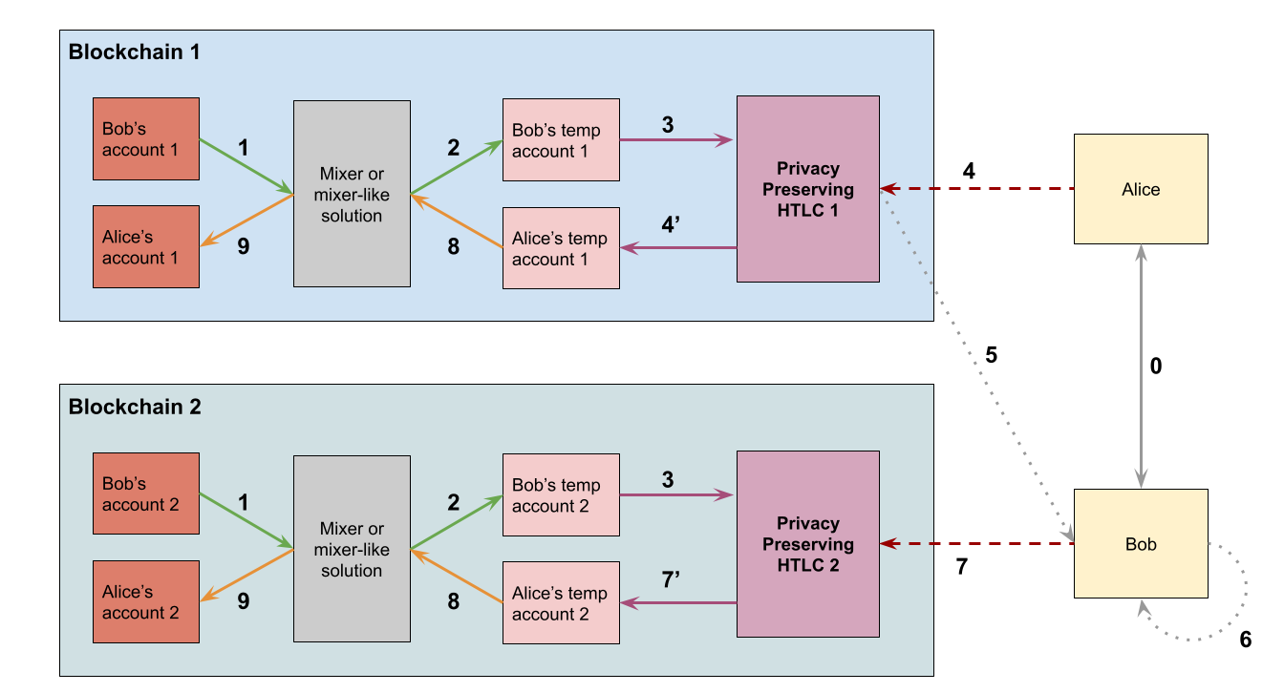
Our solution
0 - Setting up the common secret between Alice and Bob through a private, secure, offchain channel

Slide 21
Our solution
1 & 2 - Bob and Alice transfer the funds to be exchanged from their permanent accounts to temporary accounts through a mixer or mixer-like solution for anonymity

Slide 22
Our solution
3 - Setting up the privacy preserving HTLC, both using different secrets derived from the common secret set up during 0

Slide 23
Our solution
4 - Alice shares her part of the secret to HTLC 1 through her temporary account, unlocking the funds 4’ - HTLC 1 transfers the fund to Alice’s temporary account

Slide 24
Our solution
5 - Bob reads Alice newly revealed secret on HTLC 1 6 - From Alice’s secret, he infers his own secret to use on HTLC 2

Slide 25
Our solution
7 - Bob shares the secret he just inferred to HTLC 2 through his temporary account, unlocking the funds 7’ - HTLC 2 transfers the fund to Bob’s temporary account

Slide 26
Our solution
8 & 9 - Bob and Alice transfer the now exchanged funds from their temporary accounts to their permanent accounts through a mixer or mixer-like solution for anonymity

Slide 27
Current state of our solution
User addresses are no more explicitly used in contracts
Transactions on both chains are not distinguishable
BUT:
Values, tokens amounts, prices are public

Slide 28
Possible limitations
What can still bring privacy issues?
Deposits and withdrawals in raw
Using the same RPC (access node to the blockchain)
Using the same IP address
DApps’ cookies

Slide 29
4
Conclusions
Considerations & future work

Slide 30
What we have reached
privacy in cross-chain atomic swaps with use of HTLC
anonymized instantiation of a use of HTLC for the cross chain swaps
anonymity in the current systems that do not support privacy by design

Slide 31
Future work
Improvement to HTLC and to our proposed solution
Use of blockchains that are secure by design
Encryption of the content on the blockchain

Slide 32
Thanks!
Do you have any questions?

Slide 33
Bibliography
Tornadocash’s website
Why and How zk-SNARK Works - Maksym - Medium - March 2019
Privacy-Preserving Cross-Chain Atomic Swaps - Apoorvaa Deshpande and Maurice Herlihy - Brown University - August 2020
SwapCT: Swap Confidential Transactions for Privacy-Preserving Multi-Token Exchanges - Engelmann, Müller, Peter, Kargl, and Bösch - Proceedings on Privacy Enhancing Technologies ; 2021 (4) : 270–290
https://en.bitcoin.it/wiki/Main_Page
Monero — An Anonymous CryptoCurrency, Akash Kandpal

Slide 34
Blockchain 1
Bob’s account 1
Mixer or mixer-like
solution
Privacy Preserving
HTLC 1
1
Alice’s account 1
9
Blockchain 2
Bob’s account 2
Mixer or mixer-like
solution
Privacy Preserving
HTLC 2
1
Alice’s account 2
9

Slide 35
Blockchain 1
Alice Z, sA, sB, psA,
Bob’s account 1
Mixer or mixer-like
solution
Privacy Preserving
HTLC 1
Alice’s account 1
Blockchain 2
Privacy Preserving
HTLC 2
Bob’s account 2
Mixer or mixer-like
solution
Bob
Z, sA, sB,
psB, hom(psB)
Alice’s account 2

Slide 36
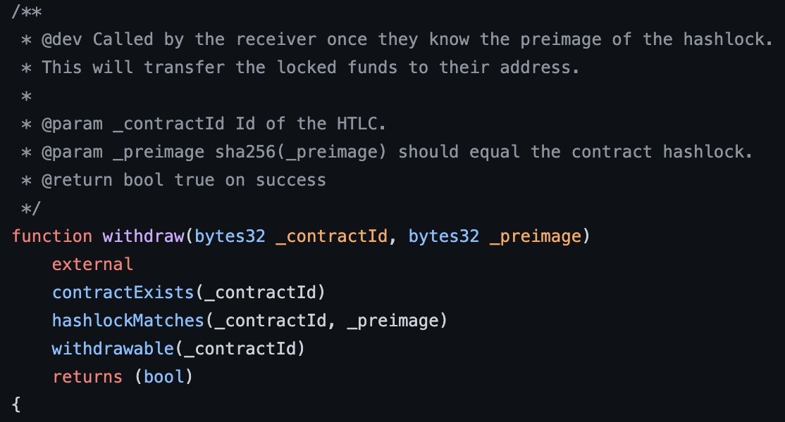

Slide 37
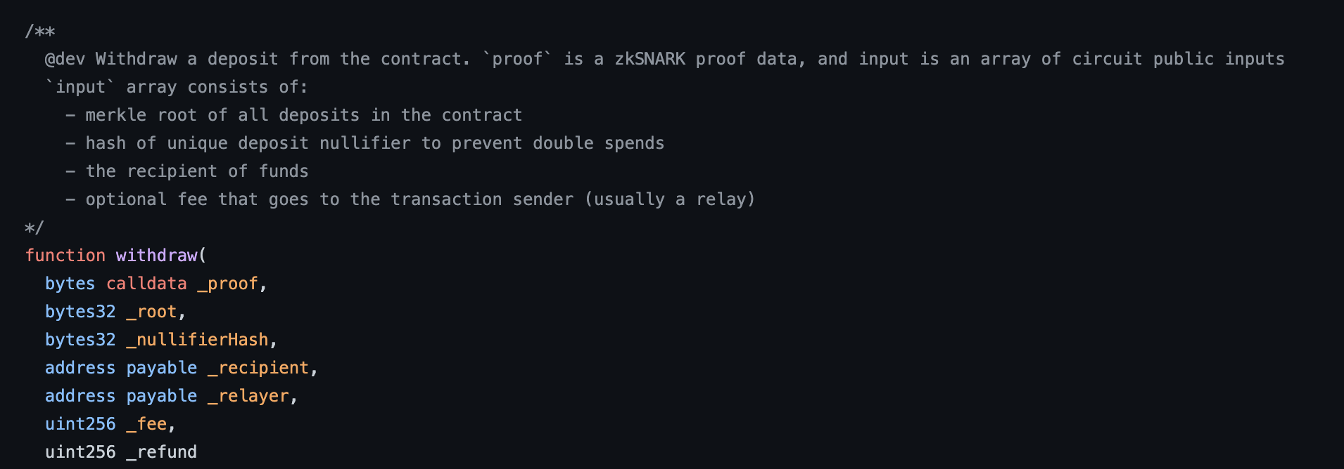

Slide 38
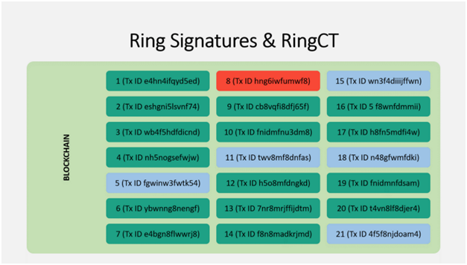
Hiding Transaction amount: how Monero does it
The Monero money supply is divided into outputs (like divisions of currency)
When you create a Monero transaction, you create a ring signature out of your transaction, and at least 5 other transactions

Slide 39
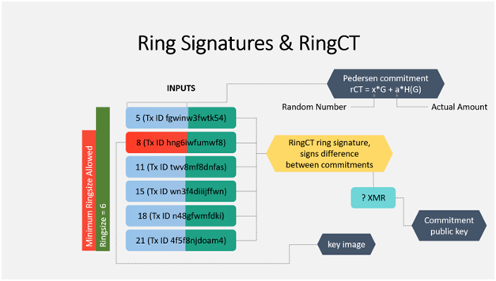
Hiding Transaction amount: how Monero does it
You will sign all inputs such that an outside observer cannot determine which is the real one being spent.
This signature includes 3 elements:
Key Image
Pedersen Commitment
Commitment Public Key

Slide 40
- the Key image is a one-way reference to the real input,
- it is given to the network as proof that the signature was created appropriately, and that the image has not been sent before (prevents double spending).
- can be verified without knowing which transaction is the real one
- The Pedersen commitment is used to commit to spending a certain value that you have the authority to spend
- it encrypts the actual number so that it cannot be seen by others.
The Commitment Public key is what is used by the network to verify the commitment.

