Slide 1
Privacy by design in embedded system
Strategie-Update 02/2022
Harald Kosch
18.03.2022

Slide 2
Presentation Outline
Privacy by Design
Embedded Systems and IoT
Privacy by Design in Embedded Systems

Slide 3
Privacy ≠ Secrecy
Privacy is not about having something to hide

Slide 4
Information Privacy
Information privacy refers to the right or ability of individuals to exercise control over the collection, use and disclosure by others of their personal information
Personally-identifiable information (“PII”) can be biographical, biological, genealogical, historical, transactional, locational, relational, computational, vocational or reputational, and is the stuff that makes up our modern identity
Personal information must be managed responsibly. When it is not, accountability is undermined and confidence in our evolving information society is eroded.

Slide 5
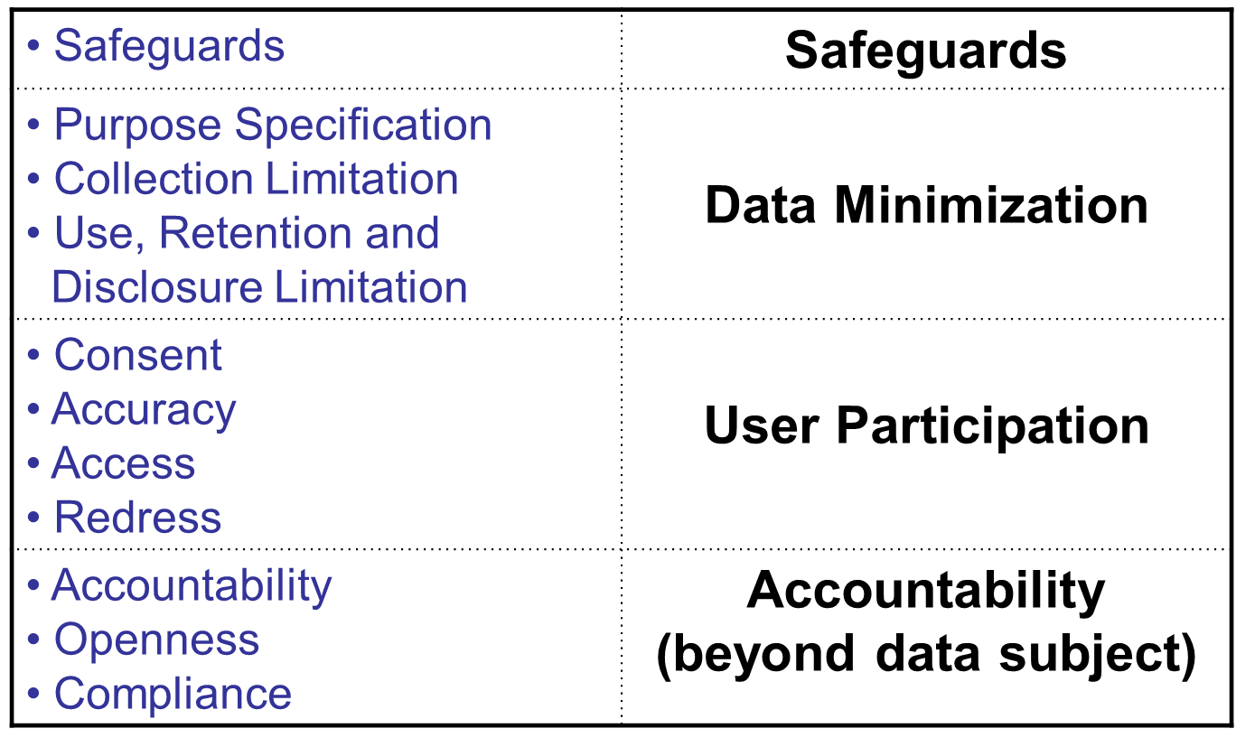
Meta Principles of Information Privacy
Notes:
Minimize collection, use, sharing, and retention of PII (e.g., limiting purposes, collection, use, disclosure, and retention)
Enhance data security (e.g., appropriate safeguards)
Actively engage the individual in managing and controlling their PII (e.g., consent, accuracy, access, challenging compliance, etc.)

Slide 6
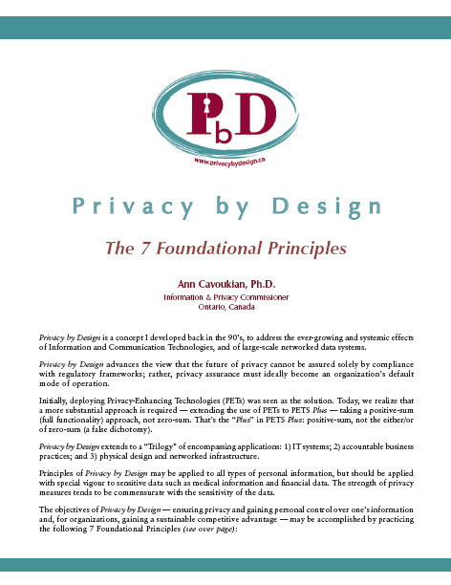
Privacy by Design: The 7 Foundational Principles
Proactive not Reactive: Preventative, not Remedial;
Privacy as the Default setting;
Privacy Embedded into Design;
Full Functionality: Positive-Sum, not Zero-Sum;
End-to-End Security: Full Lifecycle Protection;
Visibility and Transparency: Keep it Open;
Respect for User Privacy: Keep it User-Centric.
www.ipc.on.ca/images/Resources/7foundationalprinciples.pdf
Notes:
Positive-sum game, in game theory, a term that refers to situations in which the total of gains and losses is greater than zero. A positive sum occurs when resources are somehow increased and an approach is formulated in which the desires and needs of all concerned are satisfied. One example would be when two parties both gain financially by participating in a contest, no matter who wins or loses. Positive-sum outcomes occur in instances of distributive bargaining where different interests are negotiated so that everyone’s needs are met.
In contrast to the positive-sum game are the zero-sum game and the negative-sum game. The term zero-sum game refers to situations in which the total of wins and losses adds up to zero, and thus one party benefits at the direct expense of another. The term negative-sum game describes situations in which the total of gains and losses is less than zero, and the only way for one party to maintain the status quo is to take something from another party. It is in the context of negative-sum games that the most serious competition tends to occur.

Slide 7
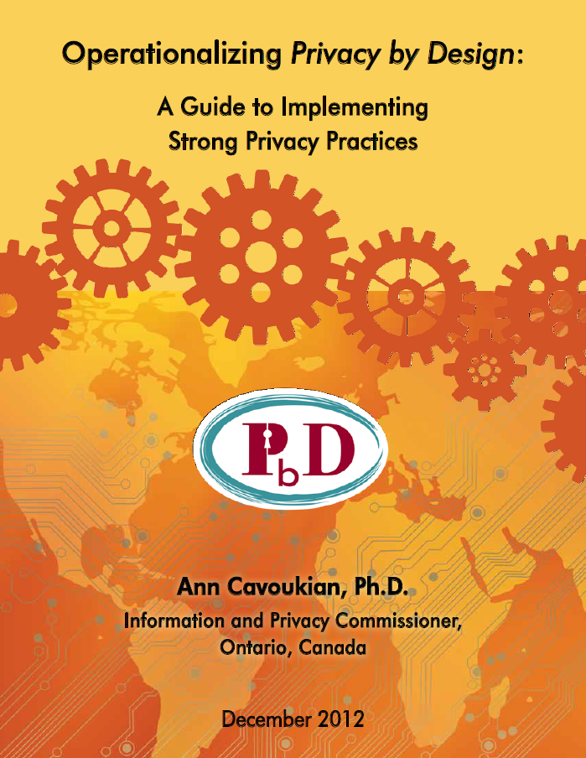
Operationalizing Privacy by Design
11 PbD Application Areas
CCTV/Surveillance cameras in mass transit systems;
Biometrics used in casinos and gaming facilities;
Smart Meters and the Smart Grid;
Mobile Communications;
Near Field Communications;
RFIDs and sensor technologies;
Redesigning IP Geolocation;
Remote Home Health Care;
Big Data and Data Analytics;
Privacy Protective Surveillance;
SmartData.

Slide 8
GDPR General Data Protection Regulation
Strengthens and unifies data protection for individuals within the European Union
Gives citizens control over their personal data and simplifies regulations across the EU by unifying regulations
Enforcement – Spring 2018

Slide 9
E.U. General Data Protection Regulation
The language of “Privacy/Data Protection by Design” and “Privacy as the Default” is appearing for the first time in a privacy statute, that was passed in the E.U.
Privacy by Design
Data Protection by Design
Privacy as the Default

Slide 10
The Similarities Between PbD and the GDPR
“Developed by former Ont. Information & Privacy Commissioner, Ann Cavoukian, Privacy by Design has had a large influence on security experts, policy markers, and regulators … The EU likes PbD … it’s referenced heavily in Article 25, and in many other places in the new regulation. It’s not too much of a stretch to say that if you implement PbD, you’ve mastered the GDPR.”
Information Age
September 24, 2015

Slide 11
Privacy Stifles Big Data Innovation
Big Data and privacy are not mutually exclusive:
Data is one of the most valuable assets of any organization ;
Privacy is about personal information;
Consumer demands are creating additional pressures;
Proactive privacy drives innovation:
It is entirely possible to achieve privacy in the Big Data era, while also using data analytics to unlock new insights and innovations to move an organization forward;
Innovation and privacy: One can have it all:
Organizations will continue to apply data analytics to Big Data in order to advance their strategic goals and better serve their customers.
— Commissioner Cavoukian,
Using Privacy by Design to achieve Big Data Innovation Without Compromising Privacy

Slide 12
Pew Research Internet Project
Public Perceptions of Privacy and Security in the Post-Snowden Era
There is widespread concern about surveillance by both government and business:
91% of adults agree that consumers have lost control over their personal information;
80% of social network users are concerned about third parties accessing their data;
80% of adults agree that Americans should be concerned about government surveillance;
https://www.pewresearch.org/internet/2014/11/12/public-privacy-perceptions/
Notes:
Pew Research Center is a nonpartisan fact tank that informs the public about the issues, attitudes and trends shaping the world. We conduct public opinion polling, demographic research, content analysis and other data-driven social science research. We do not take policy positions.

Slide 13
Embedded Systems and IoT
The network of physical objects or "things" embedded with electronics, software, sensors and connectivity to enable it to enables services by exchanging data with the manufacturer, operator and/or other connected devices.

Slide 14
Wireless and Wearable Devices
1) Wearable Computing:
Everyday objects
i.e. Apple watch, Nymi Band
2) Quantified Self:
Record information about one’s habits, lifestyle and activities (Health, Fitness and sleep trackers)
3) Home Automation:
Computer controlled thermostats, light bulbs, smart meters, the smart grid, etc.
Notes:
https://www.nymi.com/privacystatement

Slide 15
Risks in Mobile Health Apps
The U.S. Federal Trade Commission (FTC) has expressed concerns with the risks associated with the Health Information collected by the Apple Watch and HealthKit platform;
FTC found that 12 mobile health and fitness app developers were sharing user information with 76 different parties;
The FTC would like to ensure that developers have the necessary safeguards to protect personal health information.
https://www.reuters.com/article/us-healthcare-tech-washington-idUSKBN0FT02320140724

Slide 16
Remote Healthcare Monitoring and Wearable Risks
Third party monitoring removes control of one’s information from the individual involved;
The nature of the devices may make it more difficult to obtain consent before data collection begins;
Specific instances of data collection may not seem important on their own, but when aggregated, they can create a comprehensive picture of a person that may be extremely harmful to the individuals involved, especially in the hands of unauthorized third parties.

Slide 17
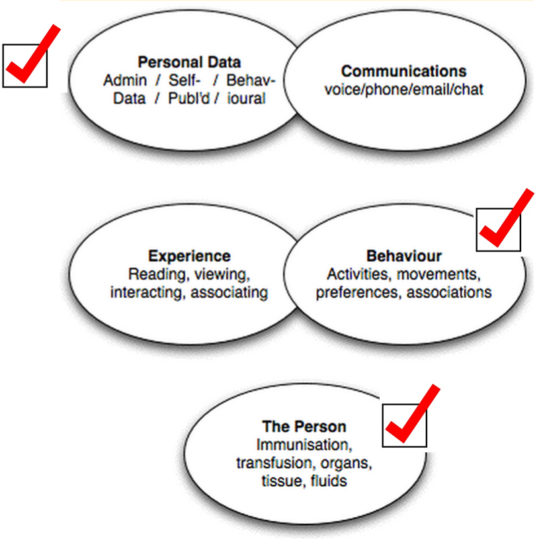
PII in Embedded Systems

Slide 18
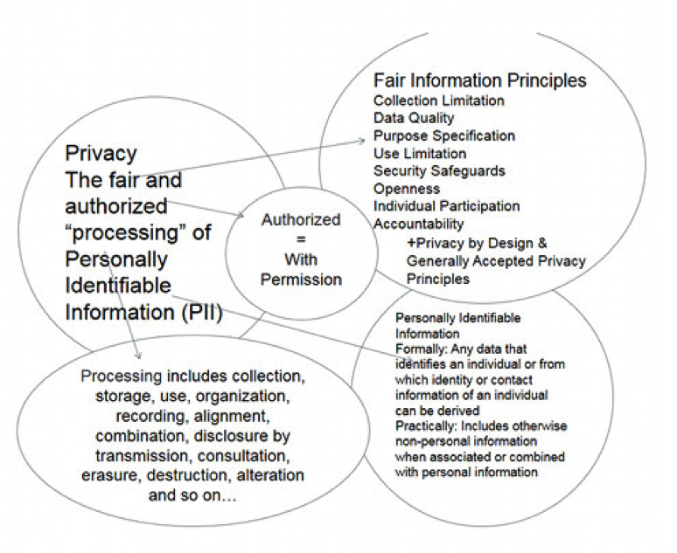
Processing of PII in Embedded Systems
Notes:
Authorized processing of personal information only happens where the person or organization is authenticated, and the processing is authorized in that the person acting has appropriate privilege for that processing.
The criteria for “fair” can be developed using laws, regulations, and enterprise privacy policies based, in part, on Privacy Frameworks such as Fair Information Processing Principles (FIPPs), Generally Accepted Privacy Principles (GAPP), Privacy by Design (PbD) and other privacy frameworks. We will discuss some privacy requirements developed from these frameworks below.
Processing personal information includes, but is not limited to: collection, storage, use, sharing, organization, display, recording, alignment, combination, disclosure by transmission, copying, consultation, erasure, destruction, alteration of personally identifiable information and any data related to it.

Slide 19
A Much-Needed Privacy Standard for the Internet of Things
Suggestion:
Creating a common privacy standard will earn user trust in privacy and security;
24 billion IoT devices before the decade is up;
Jay Cline
Computerworld
December 1, 2015
http://www.computerworld.com/article/3010626/internet-of-things/a-privacy-standard-for-internet-of-things-suppliers.html

Slide 20
Article 25 EU GDPR: Recommendations on the Internet of Things
Recommendations on the Internet of Things:
Make privacy the default setting … follow Privacy by Design;
Delete all raw data after processing;
Respect a user’s self-determination over their own data, and seek consent in a user-friendly way;
Be transparent about how a user’s data is being used;
When sensors are continuously collecting one’s personal data, remind users of this surveillance activity;
Ensure that data published to social platforms remain private, by default;
Users should not be penalized for failing to consent;
Data should be De-Identified, except when necessary.
Notes:
Article 25 EU GDPR
Data protection by design The use of pseudonymisation (replacing personally identifiable material with artificial identifiers) and encryption (encoding messages so only those authorised can read them).
Data protection by default A social media platform should be encouraged to set users’ profile settings in the most privacy-friendly setting by, for example, limiting from the start the accessibility of the users’ profile so that it isn’t accessible by default to an indefinite number of persons.
"Data protection by design and by default"
Taking into account the state of the art, the cost of implementation and the nature, scope, context and purposes of processing as well as the risks of varying likelihood and severity for rights and freedoms of natural persons posed by the processing, the controller shall, both at the time of the determination of the means for processing and at the time of the processing itself, implement appropriate technical and organisational measures, such as pseudonymisation, which are designed to implement data-protection principles, such as data minimisation, in an effective manner and to integrate the necessary safeguards into the processing in order to meet the requirements of this Regulation and protect the rights of data subjects.

Slide 21
Privacy Commissioners Declaration on the Internet of Things
Conference of Data Protection and Privacy Commissioners (2014):
The value of Internet of Things (IoT) is not only in the devices, but in the services that arise from their use;
Connectivity is ubiquitous: it is the joint responsibility of all actors to ensure trust in connected systems : Transparency is Key;
Protection should begin from the moment the data is collected:
“Privacy by Design should be the key selling point of innovative technologies”
Strong, active and constructive debate is necessary to overcome the huge challenges presented by the developers of IoT.
September, 2014
Mauritius

Slide 22
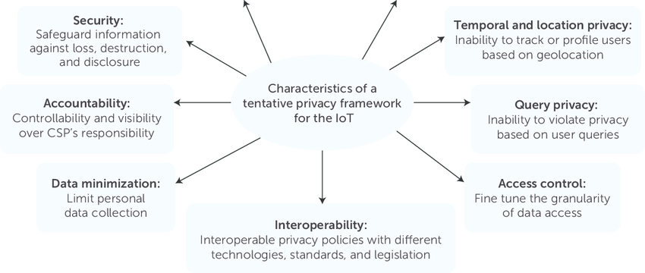
Tentative Privacy Framework
Porambage, Pawani & Schmitt, Corinna & Kumar, Pardeep & Gurtov, Andrei & Ylianttila, Mika & Vasilakos, Athanasios. (2016). The Quest for Privacy in the Internet of Things. IEEE Cloud Computing. 3. 10.1109/MCC.2016.28.

Slide 23
Pillars of Privacy and Security Embedded in Design
Privacy and Security top of mind for both Design and Development of IoT Application
Authentication Access Restrictions Data Encryption and Secure Storage
User Transparency & Control Explicit User Consent Data Containment

Slide 24
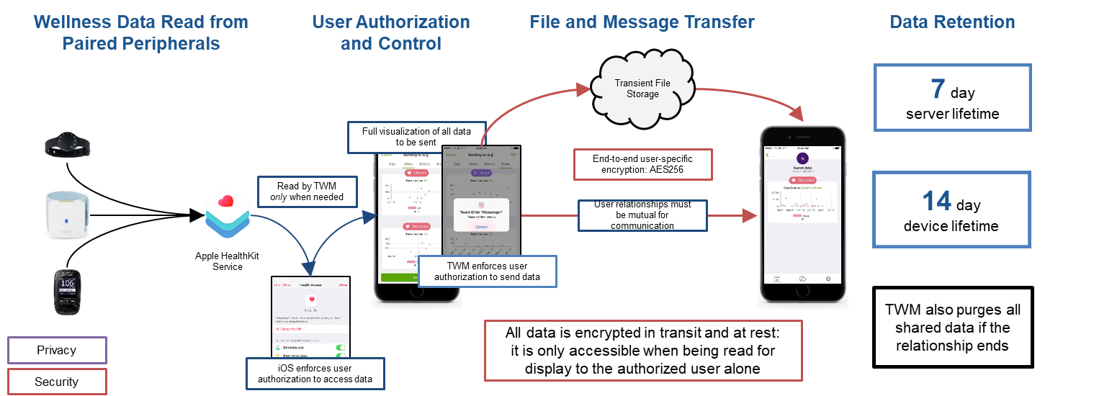
Privacy and Security as the Default

Slide 25
Data Minimization
Data minimization is the most important safeguard in protecting personally identifiable information, including for a variety of research purposes and data analysis;
The use of strong de-identification techniques, data aggregation and encryption techniques, are absolutely critical.
Notes:
Dispelling the Myths About De-Identification
HIPPA - 18 Identifiers
1. Names; 2. All geographical subdivisions smaller than a State, including street address, city, county, precinct, zip code, and their equivalent geocodes, except for the initial three digits of a zip code; 3. All elements of dates (except year) for dates directly related to an individual, including birth date, admission date, discharge date, date of death; and all ages over 89 and all elements of dates (including year) indicative of such age, except that such ages and elements may be aggregated into a single category of age 90 or older; 4. Phone numbers; 5. Fax numbers; 6. Electronic mail addresses; 7. Social Security numbers; 8. Medical record numbers; 9. Health plan beneficiary numbers; 10. Account numbers; 11. Certificate/license numbers; 12. Vehicle identifiers and serial numbers, including license plate numbers; 13. Device identifiers and serial numbers; 14. Web Universal Resource Locators (URLs); 15. Internet Protocol (IP) address numbers; 16. Biometric identifiers, including finger and voice prints; 17. Full face photographic images and any comparable images; and 18. Any other unique identifying number, characteristic, or code (note this does not mean the unique code assigned by the investigator to code the data)

Slide 26
De-Identification
Indirectly identifying variables (quasi-identifiers): probabilistically identify an individual, e.g., sex, date of birth or age, geo-codes, first language, ethnic origin, aboriginal identity …
High
Aggregate data
De-identified data
Privacy
Potentially De-identified data
Identifiable data
Directly identifying variables: uniquely identify an individual, e.g., name, phone number, email address, health insurance card number, credit card number and social insurance number.
Low

Slide 27
De-Identification…
If proper de-identification techniques and re-identification risk management procedures are used, re-identification becomes a very difficult task;
While there may be a residual risk of re-identification, in the vast majority of cases, de-identification will strongly protect the privacy of individuals when additional safeguards are in place.
Personally identifiable data must be rendered non-identifiable;
Strong de-identification protocols must be used in conjunction with a risk of re-identification framework.
Notes:
Evidence the Tool Works

Slide 28
Data minimization and De-Identified Data
De-Identification and data minimization are among the most important safeguards in protecting personal information;
You should not collect, use or disclose personal information if other data (i.e., de-identified, encrypted or obfuscated) will serve the purpose;
The use of strong de-identification, aggregation, and encryption techniques are absolutely critical, and readily available.

Slide 29
Privacy in Embedded Systems:
Internet of Vehicule
Non Intrusive Load Monitors (NILM)

Slide 30
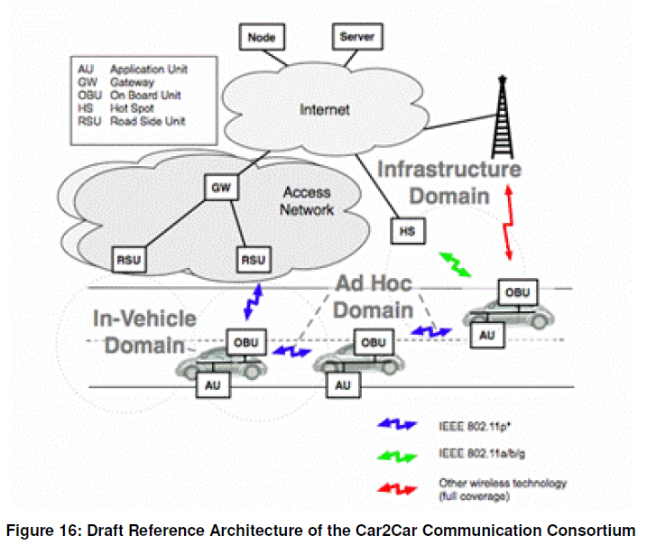
Internet of Vehicle
Refers to the vehicles to vehicles, vehicles to roads, vehicles to people, vehicles to sensing equipment interaction, implement dynamic mobile communication system of the vehicles with the public network.

Slide 31
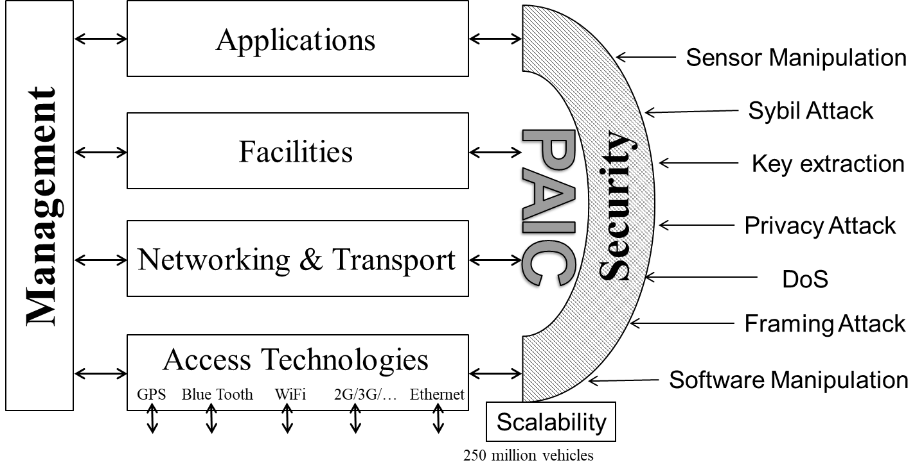
ITS Station Reference Architecture (ISO 21217)

Slide 32
Privacy Issues and Risks
Privacy Issues:
Untraceability: vehicle’s action should not be traced
Unlinkability: vehicle’s identity should not be identified
Weak Anonymity: vehicles should not be identified from the messages they send
Strong Anonymity: no message are linkable vehicles
Location Privacy
Location of a vehicle over time should remain private
Privacy Risks:
Two types
Real time (where the vehicle is presently located) or
Historic (where the vehicle was at a certain time on a certain day).
Locate and track specific vehicles.
Location → unique vehicle identifier (or series of identifiers) → an individual (a registered owner).

Slide 33
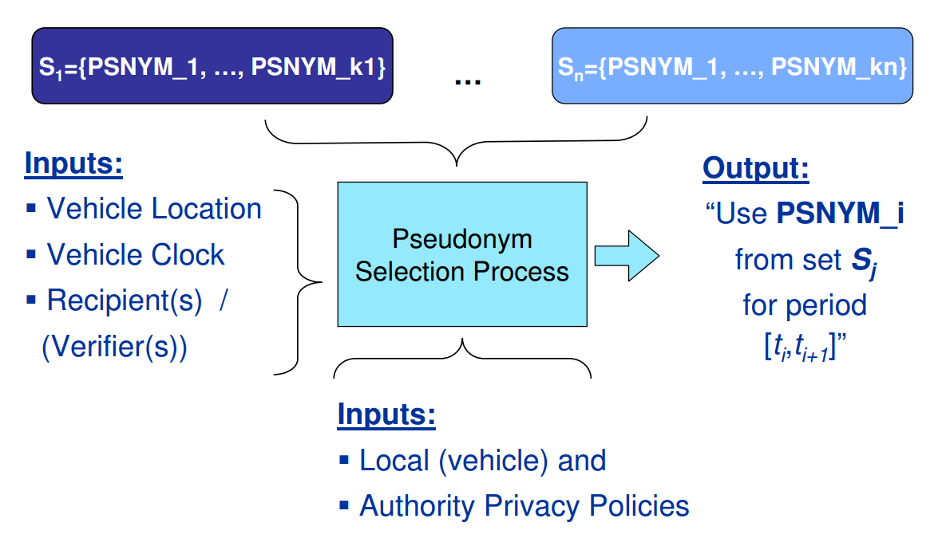
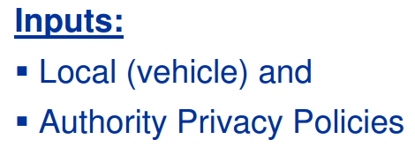
Pseudonyms
Not allow for message sender to be identified.
Difficult to link two or more messages to a specific node.

Slide 34
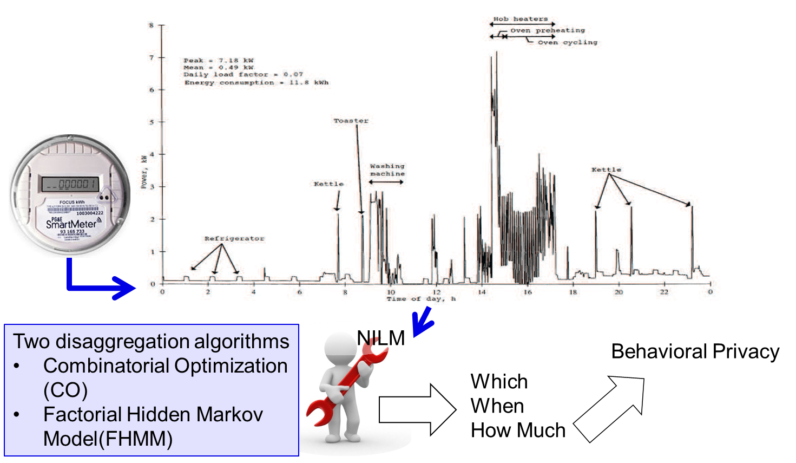
Non Intrusive Load Monitors (NILM)
Notes:
The goal of a NILL system is to level the load profile to a con- stant target load, thus removing appliance features. To achieve this, NILL relies on a battery to offset the power consumed by appli- ances. When an appliance turns ON, it will exert a load beyond the target load. Thus, NILL will discharge the battery to partially sup- ply the load created by the appliance, maintaining the target load.4 Similarly, if an appliance enters the OFF state, the load profile will decrease below the target load. These opportunities are used to charge the battery while restoring the target load. The NILL sys- tem presented here consists of two parts: a battery and a control system that regulates the battery’s charge and discharge based on the present load and battery state. The controller attempts to main- tain a steady state target load KSS , but will go into one of two special states KL or KH if the battery needs to recover from a low or high state of charge. This section describes the NILL runtime control system and the calculation of the initial system parameters.

Slide 35
“Privacy by Design – Ready for Takeoff”
The passage of the EU’s GDPR … is bringing PbD to top of mind as personal operations are adjusted to comply with new GDPR rules…In short, the GDPR has already given PbD new visibility and vigor. Positive-sum change is on its way – not just to Europe, but across the world.
Privacy Elephant
November 4, 2016
http://privacyelephant.blogspot.ca/2016/11/privacy-by-design-ready-for-takeoff.html

Slide 36
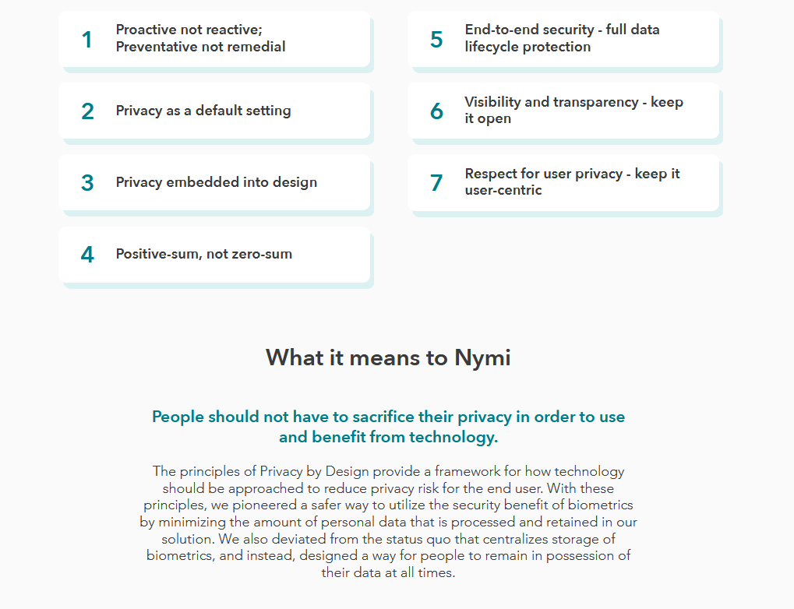
Privacy by Design – Hope ☺

Slide 37
Conclusion
Privacy and security risks are best managed by proactively embedding the principles of Privacy by Design;
Focus on prevention: It is much easier and far more cost-effective to build in privacy and security, up-front, rather than after-the-fact, reflecting the most ethical treatment of personal data;
Abandon zero-sum thinking – embrace doubly-enabling systems: Privacy and Security; Privacy and Data Utility;

